Slide 1
Head and Neck Cancer International Group (HNCIG) classification for extranodal extension on imaging (iENE)
iENE negative (Grade 0): None of the radiological features of iENE below
iENE Grade 1: Clearly irregular or ill-defined nodal margins and/or extension into and confined to perinodal fat
iENE Grade 2: Clear invasion through two or more inseparable adjoining lymph nodes, also known as conglomerate or matted or coalescent nodes +/- grade 1 features
iENE Grade 3: Clear extension into adjacent structures such as muscle, skin, glands, neurovascular bundle +/- grade 1 or 2 features
Notes: In your textual report, please indicate all features that are clearly present, and any features that are equivocal. Then please indicate the highest overall grade of features that are clearly present.
If a feature is equivocal – then it is considered as ‘absent’ in terms of grade.
E.g., if a case has clear extension into perinodal fat but equivocal presence of coalescent nodes, then the case is assigned Grade 1, not Grade 2

Slide 2
iENE Grade 0 Grade 0: None of the radiological features of iENE

Slide 4
Grade 0 on CT scan
Axial and coronal CT
Left Ib node
Clean peripheral margins

Slide 5
Grade 0 - multiple planes on CT scan
Clean peripheral margins
Clean peripheral margins
Axial Sagittal and Coronal CT
Left level II node
Grade 0

Slide 6
Grade 0 on MRI
clean defined margins
clean defined margins
clean defined margins
MRI Axial T2 fat sat, Axial T2 and Sagittal T1
Right level II - clean defined margins
Grade 0

Slide 7
iENE Grade 1 iENE Grade 1 : Clearly irregular or ill-defined nodal margins and/or extension into and confined to perinodal fat

Slide 8
Grade 1 on MRI
MRI sagittal: Irregular margins around node periphery
Grade 1

Slide 9
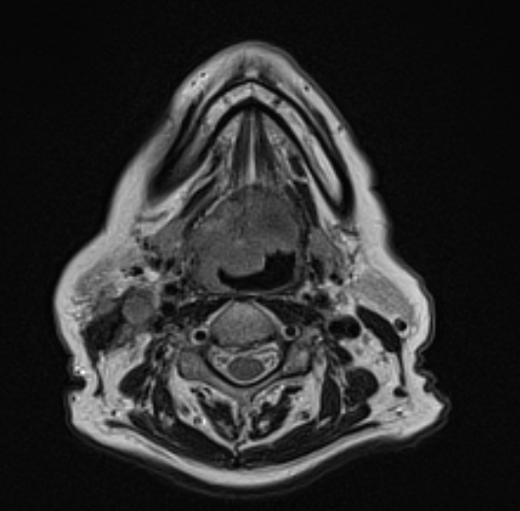
Grade 1 on MRI
MRI axial: Rt level II node with ill defined margins
Grade 1

Slide 10
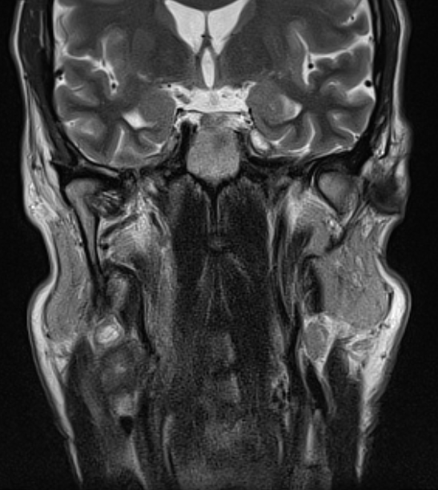
Grade 1 on MRI
Ill-defined node

Slide 11
Grade 1 on CT scan
Coronal contrast enhanced CT:
Left level II node with spiculation
extending into the perinodal fat
Grade 1
Grade 1 ENE

Slide 12
Grade 1 on CT scan
CT scan - axial:
Ill defined margins with stranding into fat
Grade 1
Now focus on this node – ill defined margins
with stranding into the adjacent fat – so G1

Slide 13
Grade 1 on CT scan
Stranding into perinodal fat
Grade 1

Slide 14
Grade 1 on CT scan
Stranding into perinodal fat

Slide 15
Grade 1 on CT scan
Stranding into perinodal fat

Slide 16
Grade 1 on CT scan
CT axial:
Irregular margins with extension
Into perinodal fat
Grade 1

Slide 17
Grade 1 on CT scan
Grade 1 node – irregular margins with extension into perinodal fat

Slide 18
Grade 1 on CT scan
Grade 1 node – irregular margins with extension into perinodal fat
Example of a Grade 0 node in comparison

Slide 19
Grade 1 on CT scan
CT scan – axial:
Irregular margins and extension
into perinodal fat
Grade 1

Slide 20
Grade 1 on CT scan
Irregular margins and extension
into perinodal fat
Grade 1

Slide 21
Grade 1 on CT scan
Irregular margins and extension
into perinodal fat
Grade 1

Slide 22
Grade 1 on CT scan
Irregular margins and extension
into perinodal fat
Grade 1

Slide 23
Grade 1 on CT scan
Irregular margins and extension
into perinodal fat
Grade 1

Slide 24
Grade 1 on CT scan
CT scan - sagittal:
Extension of tumour into surrounding fat
- indicated by arrow
Grade1

Slide 25
Grade 1 on CT scan
CT scan
Extension of tumour into surrounding fat
- indicated by arrow
Grade1

Slide 26
Arrows indicate the probable location of coalescence

Slide 27
Grade 2 on MRI
Axial and coronal CT series – arrows show numerous nodes that as you scroll through become inseparable i.e. - coalescent
node
node
node

Slide 28
Grade 2 on MRI
Arrows indicate inseparable i.e. coalescent nodes
node
node
node

Slide 29
Grade 2 on MRI
Arrows indicate inseparable i.e. coalescent nodes
node
node

Slide 30
Grade 2 on MRI
Arrows indicate inseparable i.e. coalescent nodes
node
node

Slide 31
Grade 2 on MRI
Arrows indicate inseparable i.e. coalescent nodes
node
node
node
node
node
node

Slide 32
Grade 2 on MRI
Same case on sagittal
Arrows show conglomeration
of nodes
node
node
node

Slide 33
Grade 2 on MRI
Arrows indicate inseparable i.e. coalescent nodes
node
node
node

Slide 34
Grade 2 on MRI
Arrows indicate inseparable i.e. coalescent nodes
node
node

Slide 35
Grade 2 on MRI
Arrows indicate inseparable i.e. coalescent nodes
node
node
node

Slide 36
Grade 2 on MRI
Arrows indicate inseparable i.e. coalescent nodes
node
node
node
node
node

Slide 37
Grade 2 on MRI
Arrows indicate inseparable i.e. coalescent nodes
node
node
node
node
node

Slide 38
Utility of different imaging planes to ascertain Grade 2 coalescence

Slide 39
For Grade 2 – look at different planes – see if the nodes are just touching and have visible borders separating them like in this example – if Yes – then NOT coalescent
Sagittal CT shows the importance of making use of different imaging planes to help confirm the presence or as in this case, the absence of coalescence. The circled examples show nodes clustered together but still with distinct radiologically visible planes separating them

Slide 40
Another example of two nodes that happen to touch but the coronal plane nicely shows clean distinct separation of the two nodes (i.e. not meeting criteria for iENE)

Slide 41
Grade 2 on CT scan

Slide 42
Grade 2 on CT scan
CT scan axial
Coalescent multiple nodes
Grade 2
Focus on the nodes in the left parotid region – as you scroll, arrows will highlight the presence of multiple nodes. These nodes are coalescent. They become as one without visible planes of separation = Grade 2

Slide 43
Grade 2 on CT scan
Coalescent nodes without visible planes of separation = Grade 2
node
node

Slide 44
Grade 2 on CT scan
Coalescent nodes without visible planes of separation = Grade 2
node
node
node
node

Slide 45
Grade 2 on CT scan
Coalescent nodes without visible planes of separation = Grade 2
node
node
node
node

Slide 46
Grade 2 on CT scan
Coalescent nodes without visible planes of separation = Grade 2
node
node

Slide 47
Grade 2 on CT scan
Coalescent nodes without visible planes of separation = Grade 2
node
node

Slide 48
Grade 2 on CT scan
Same group of nodes
On coronal CT scan
Grade 2

Slide 49
Grade 2 on CT scan
Now the same left parotid tail nodal mass
As we scroll through – the arrows show the presence of multiple separate nodes that have coalesced together

Slide 50
Grade 2 on CT scan
Arrows indicate coalescent nodes
node
node

Slide 51
Grade 2 on CT scan
Arrows indicate coalescent nodes
node
node

Slide 52
Grade 2 on CT scan
Arrow indicates coalescent nodes

Slide 53
Grade 2 on CT scan
node
Arrows indicate coalescent nodes
node

Slide 54
Grade 2 on CT scan
node
Arrows indicate coalescent nodes
node
node

Slide 55
Grade 2 on CT scan
node
node
Arrows indicate coalescent nodes
node

Slide 56
Grade 2 on CT scan
Arrows indicate coalescent nodes
node
node

Slide 57
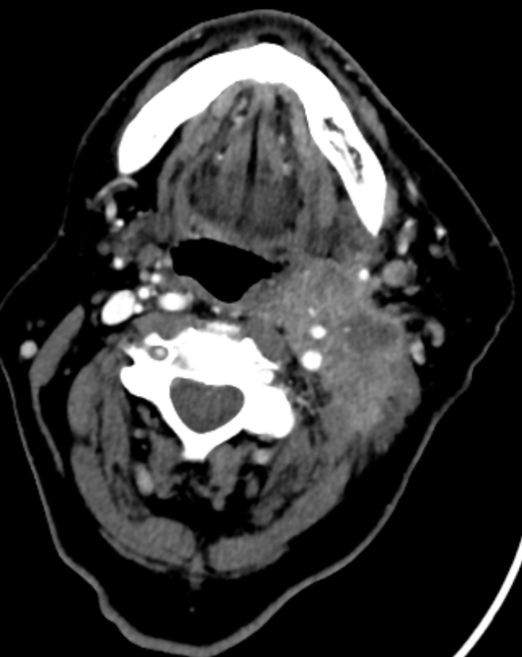
iENE Grade 3 iENE Grade 3- involvement of other structures eg carotid artery, skin, platysma
CT of Grade 3 –
carotid is encased

Slide 58
Grade 3 (with features of Grade 2) on MRI
Series of MRI images – this is ultimately G3 due to carotid encasement but also shows features of underlying G2 coalescence of nodes

Slide 59
Grade 3 (with features of Grade 2) on MRI
As we scroll through this Axial and then coronal set of T2 MRI images, focus on the left level II nodal mass – arrows will show the presence of multiple nodes that have become inseparable within the coalescent/conglomerate mass

Slide 60
Grade 3 (with features of Grade 2) on MRI
As we scroll through this Axial and then coronal set of T2 MRI images, focus on the left level II nodal mass – arrows will show the presence of multiple nodes that have become inseparable within the coalescent/conglomerate mass
node
node

Slide 61
Grade 3 (with features of Grade 2) on MRI
As we scroll through this Axial and then coronal set of T2 MRI images, focus on the left level II nodal mass – arrows will show the presence of multiple nodes that have become inseparable within the coalescent/conglomerate mass
node
node

Slide 62
Grade 3 (with features of Grade 2) on MRI
This shows the left ICA encased by the nodal mass
= Grade 3

Slide 63
Grade 3 (with features of Grade 2) on MRI
Arrows on coronal MRI
show coalescent nodes

Slide 64
Grade 3 (with features of Grade 2) on MRI
Arrows on coronal MRI
show coalescent nodes

Slide 65
Grade 3 (with features of Grade 2) on MRI
Arrows on coronal MRI
show coalescent nodes

Slide 66
Grade 3 (with features of Grade 2) on MRI
Arrows on coronal MRI
show coalescent nodes

Slide 67
Grade 3 (with features of Grade 2) on MRI
node
Arrows on coronal MRI
show coalescent nodes
node

Slide 68
Grade 3 on MRI
Axial and coronal CT series – arrows show numerous nodes that as you scroll through become inseparable ie - coalescent , but then they encase the carotid at last slide, making the case a Grade 3.
node
node
node

Slide 69
Grade 3 on MRI
Axial and coronal CT series – arrows show numerous nodes that as you scroll through become inseparable ie - coalescent , but then they encase the carotid at last slide, making the case a Grade 3.
node
node
node

Slide 70
Grade 3 on MRI
Axial and coronal CT series – arrows show numerous nodes that as you scroll through become inseparable ie - coalescent , but then they encase the carotid at last slide, making the case a Grade 3.
node
node

Slide 71
Grade 3 on MRI
Axial and coronal CT series – arrows show numerous nodes that as you scroll through become inseparable ie - coalescent , but then they encase the carotid at last slide, making the case a Grade 3.
node
node
node

Slide 72
Grade 3 on MRI
Axial and coronal CT series – arrows show numerous nodes that as you scroll through become inseparable ie - coalescent , but then they encase the carotid at last slide, making the case a Grade 3.
node
node
node
node
node
node

Slide 73
Grade 3 on MRI
Ultimately this is again G3 as the ICA is encased

Slide 74
Other examples of Grade 3 on MRI and CT scan

Slide 75
MRI Grade 3 CT scan Grade 3 MRI Grade 3
SCM, platysma, skin, IJV
Skin, SCM, platysma
Skin, platysma

Slide 76
The following slides illustrate an example of potential pitfall due to core biopsy. They show a level II transverse ultrasound during core needle biopsy, with no evidence of iENE. This patient bled following the procedure. The subsequent CT with contrast is shown, which could easily be interpreted as demonstrating iENE if the reviewer was unaware of this history.

Slide 77
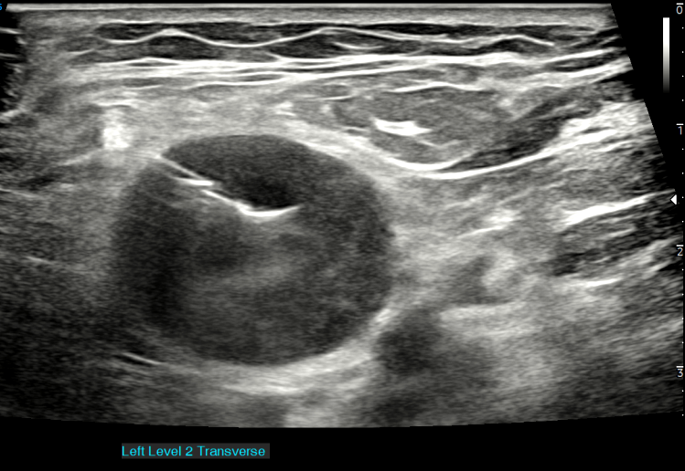
26 sept 2023

Slide 78
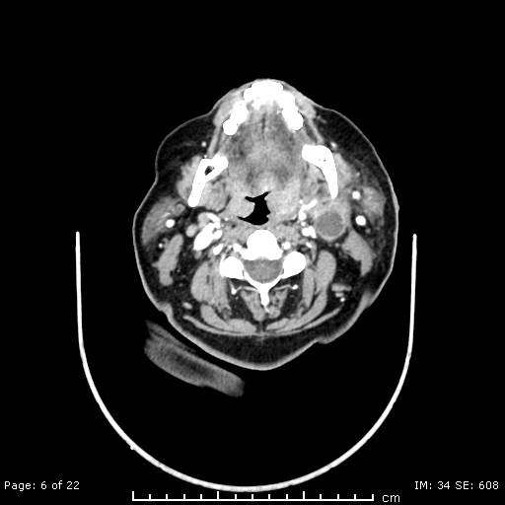
29 sept 2023

Slide 79
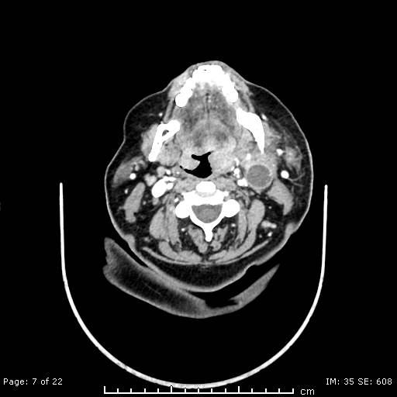
29 sept 2023

Slide 80
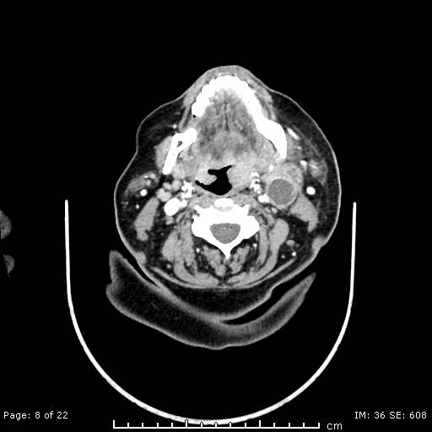
29 sept 2023

Slide 81
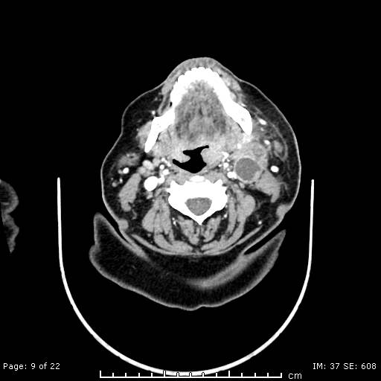
29 sept 2023

Slide 82
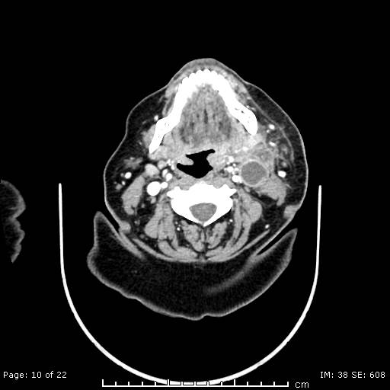
29 sept 2023

Slide 83
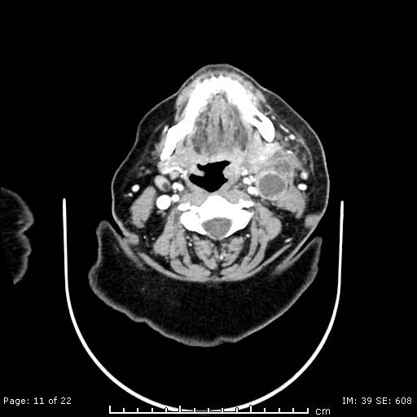
29 sept 2023

Slide 84
29 sept 2023

Slide 85
29 sept 2023

Slide 86
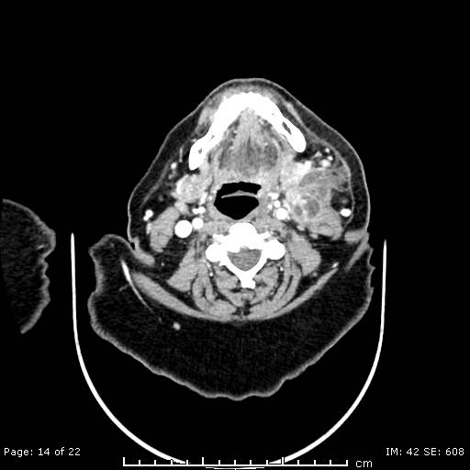
29 sept 2023

Slide 87
29 sept 2023

Slide 88
29 sept 2023

Slide 89
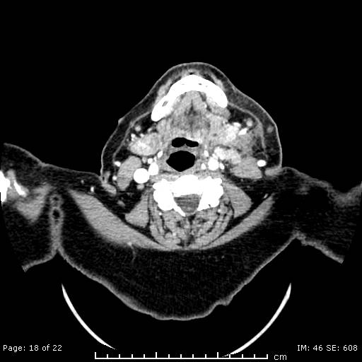
29 sept 2023

Slide 90
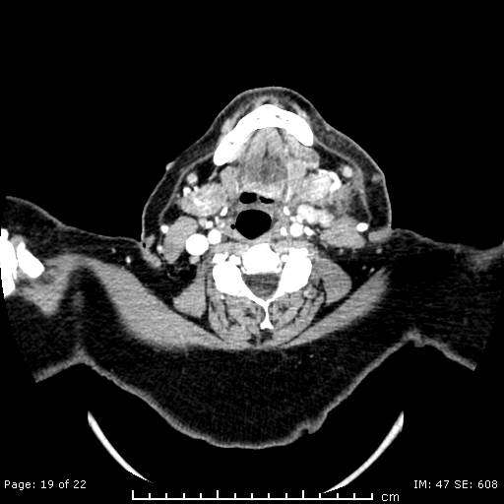
29 sept 2023

Slide 91
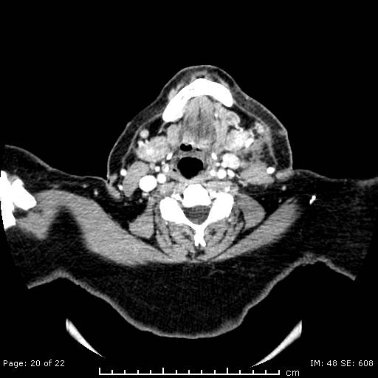
29 sept 2023

Slide 92
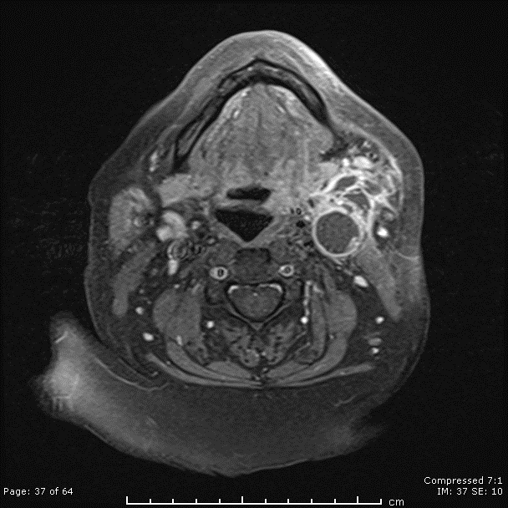
29 sept 2023

Slide 93
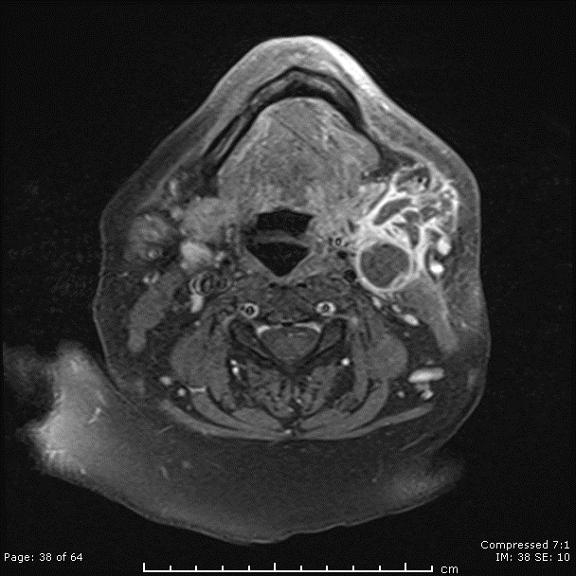
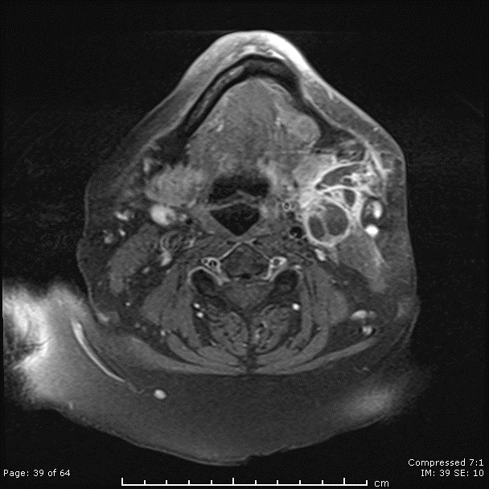
29 sept 2023

Slide 94
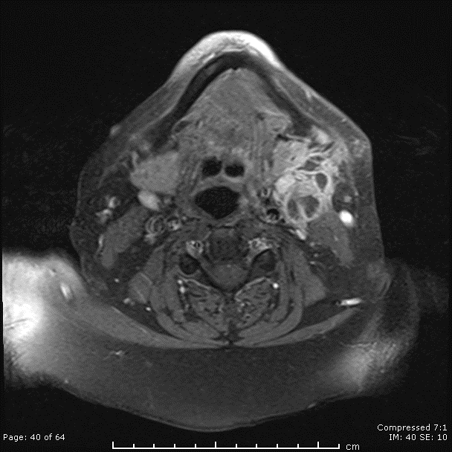
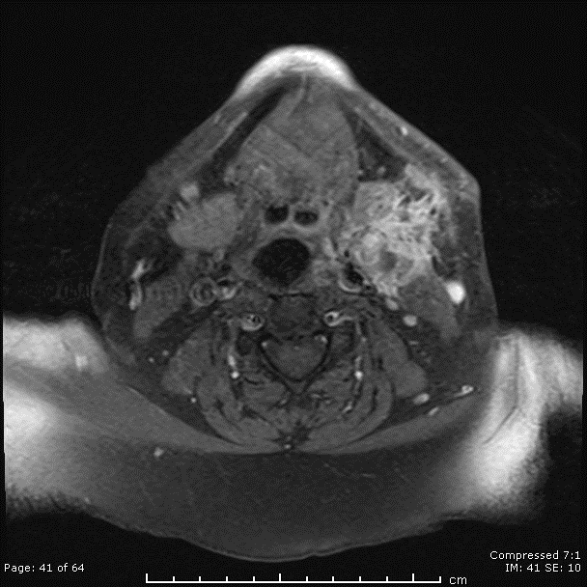
29 sept 2023

Slide 95
29 sept 2023

