Slide 1

Standardised definitions and diagnostic criteria for extranodal extension on histopathological examination in head and neck cancer: HNCIG international consensus recommendations

Slide 2
Standardised definitions and diagnostic criteria for extranodal extension on histopathological examination in head and neck cancer: HNCIG international consensus recommendations
Features diagnostic of pENE for both HPV-mediated and HPV-negative HNC: Tumour directly extending into perinodal soft tissue Tumour cells in perinodal fat/soft tissue Penetration of tumour cells through the full thickness of the lymph node capsule

Slide 3
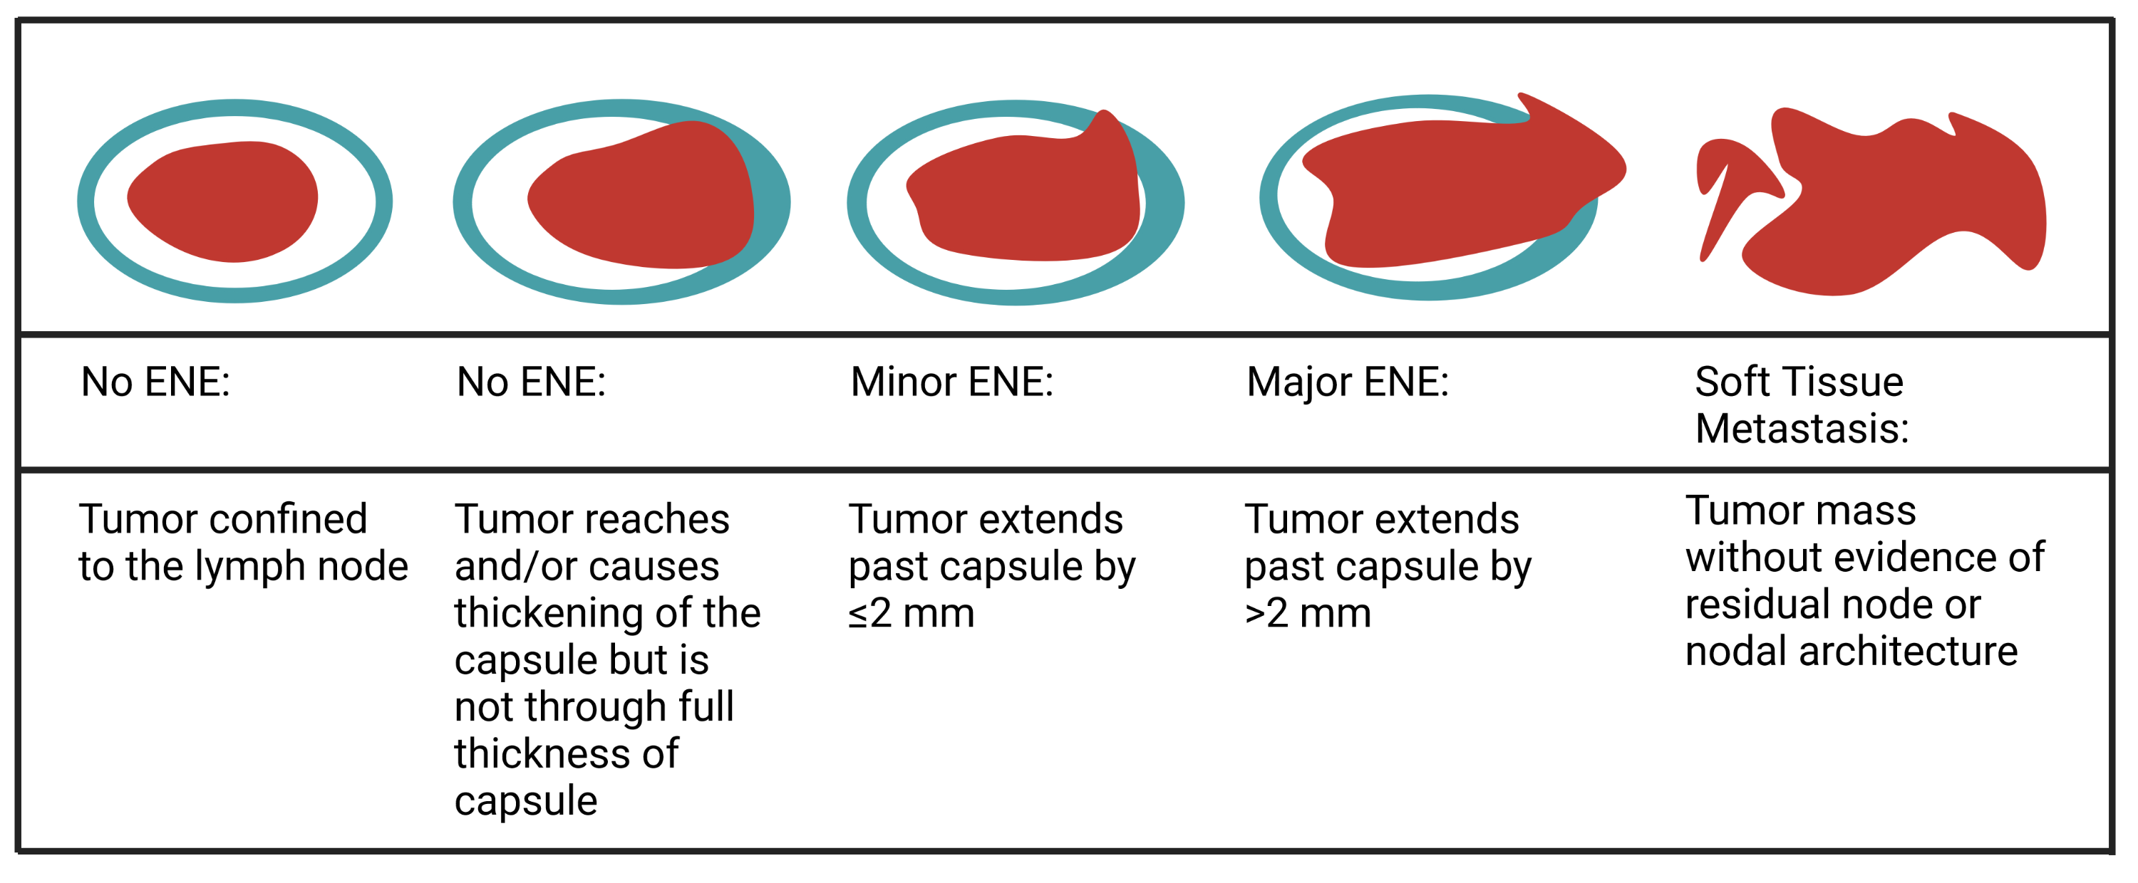
Schematic diagram of the diagnostic criteria for pathological extranodal extension and soft tissue metastasis

Slide 4
Examples of cases with no pENE and possible pitfalls - cases that are NOT pENE but could be confused as such

Slide 5
Standardised definitions and diagnostic criteria for extranodal extension on histopathological examination in head and neck cancer: HNCIG international consensus recommendations
Features NOT diagnostic for pENE: Absence of lymphoid tissue Thick pseudocapsule Presence of matted nodes Vascular invasion by cancer cells in perinodal soft tissue Tumour within lymphatics near an involved lymph node Tumour infarction in the lymph node due to core biopsy or FNA Lymph node infarction due to core biopsy or FNA Linear needle tract with recent or old haemorrhage and neovascular proliferation due to core biopsy or FNA Reactive fibroblastic proliferation with hemosiderin-laden macrophages due to core biopsy or FNA

Slide 6
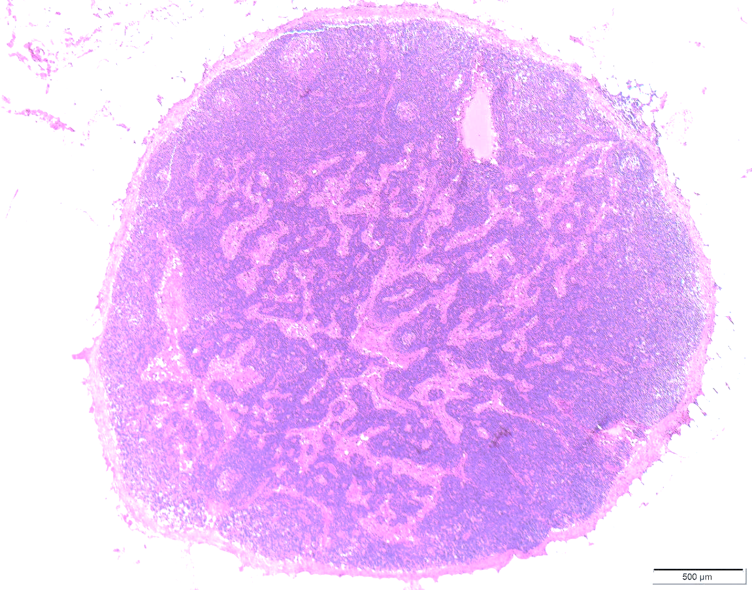
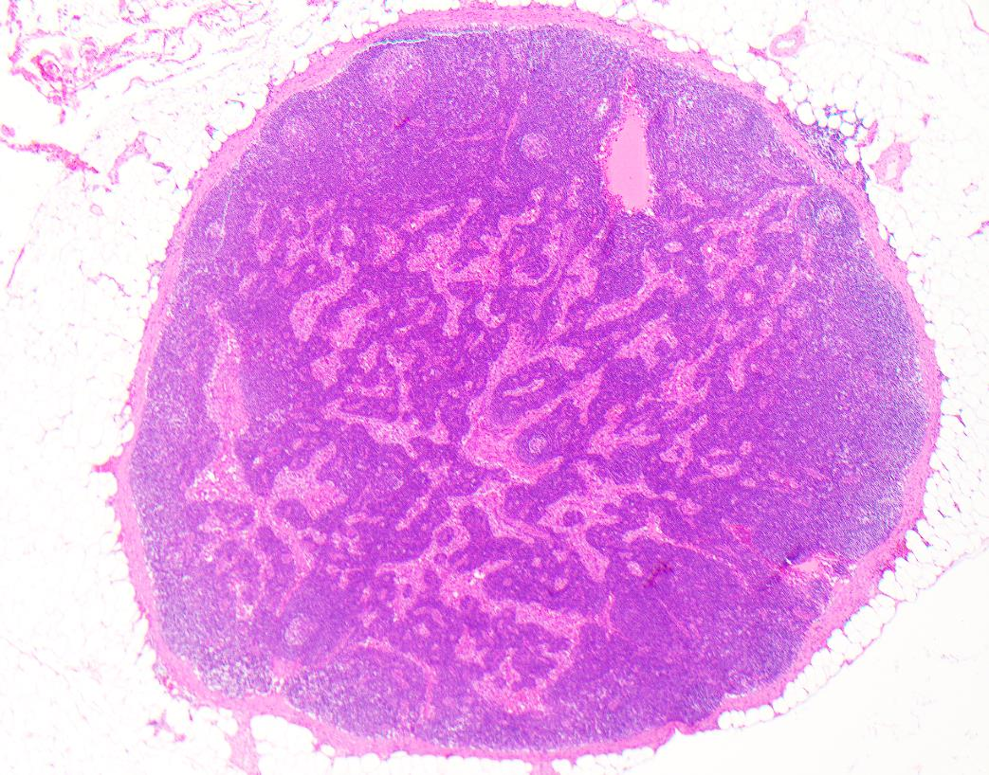
Normal lymph node without metastasis
Thin capsule (A) with subcapsular sinus containing histiocytes (B).
A
B
Notes:
RDC ADDED

Slide 7
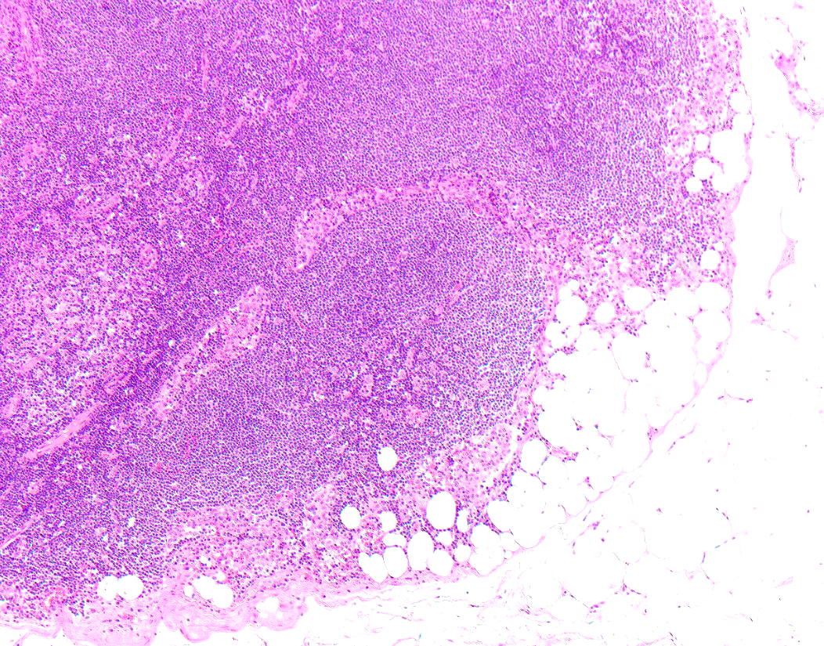

Normal lymph node
Subcapsular, intranodal adipose tissue (A), a potential pitfall in assessing for pENE
A
Notes:
RDC ADDED

Slide 8
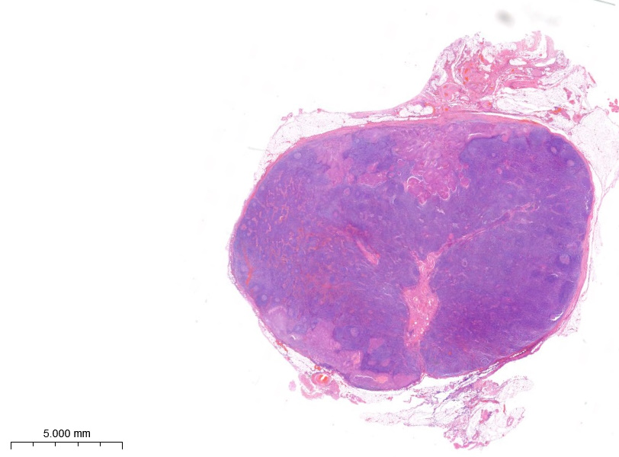
No pENE (Case 1)
Metastatic SCC in the sub-capsular sinus (A) and cortex (B). The capsule (C) is intact.
There is no extranodal extension.
C
A
B

Slide 9
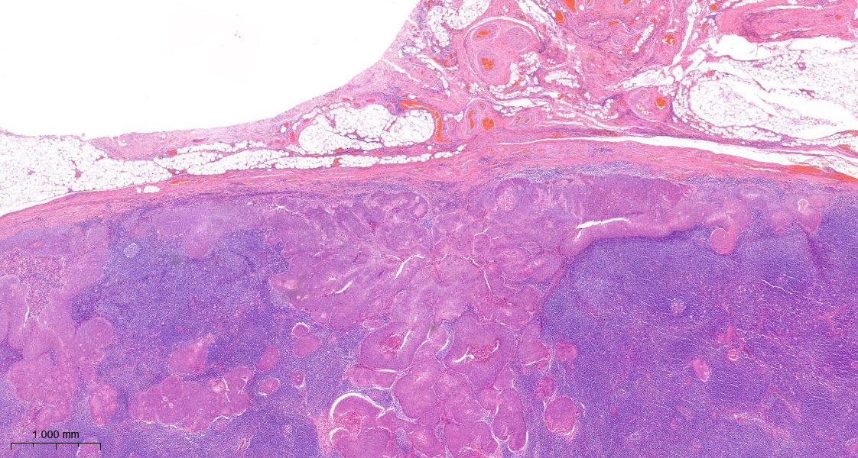
No pENE (Case 1 high power)
Metastatic SCC in the sub-capsular sinus (A) and cortex (B). The capsule (C) is intact.
There is no extranodal extension.
C
A
B

Slide 10
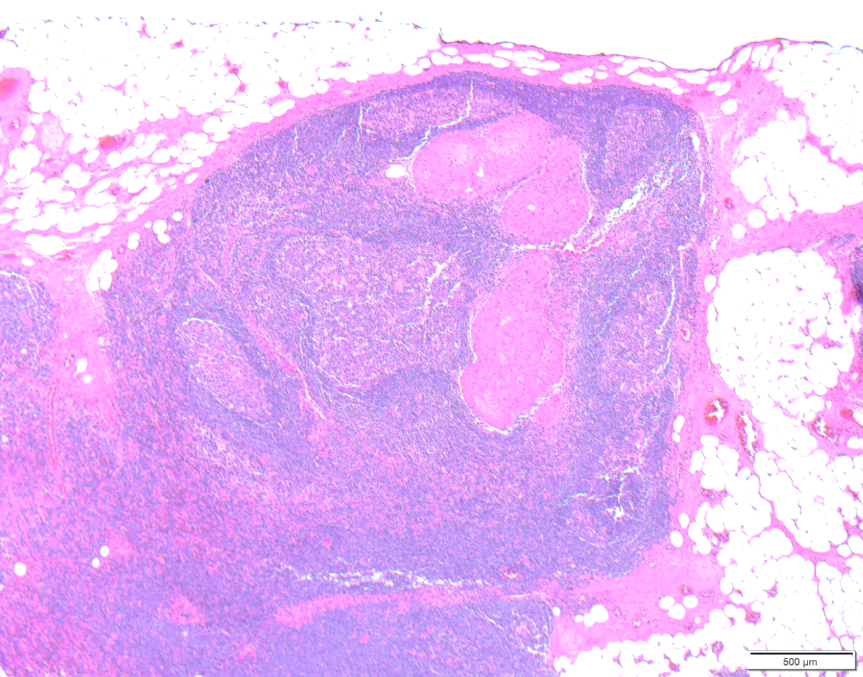
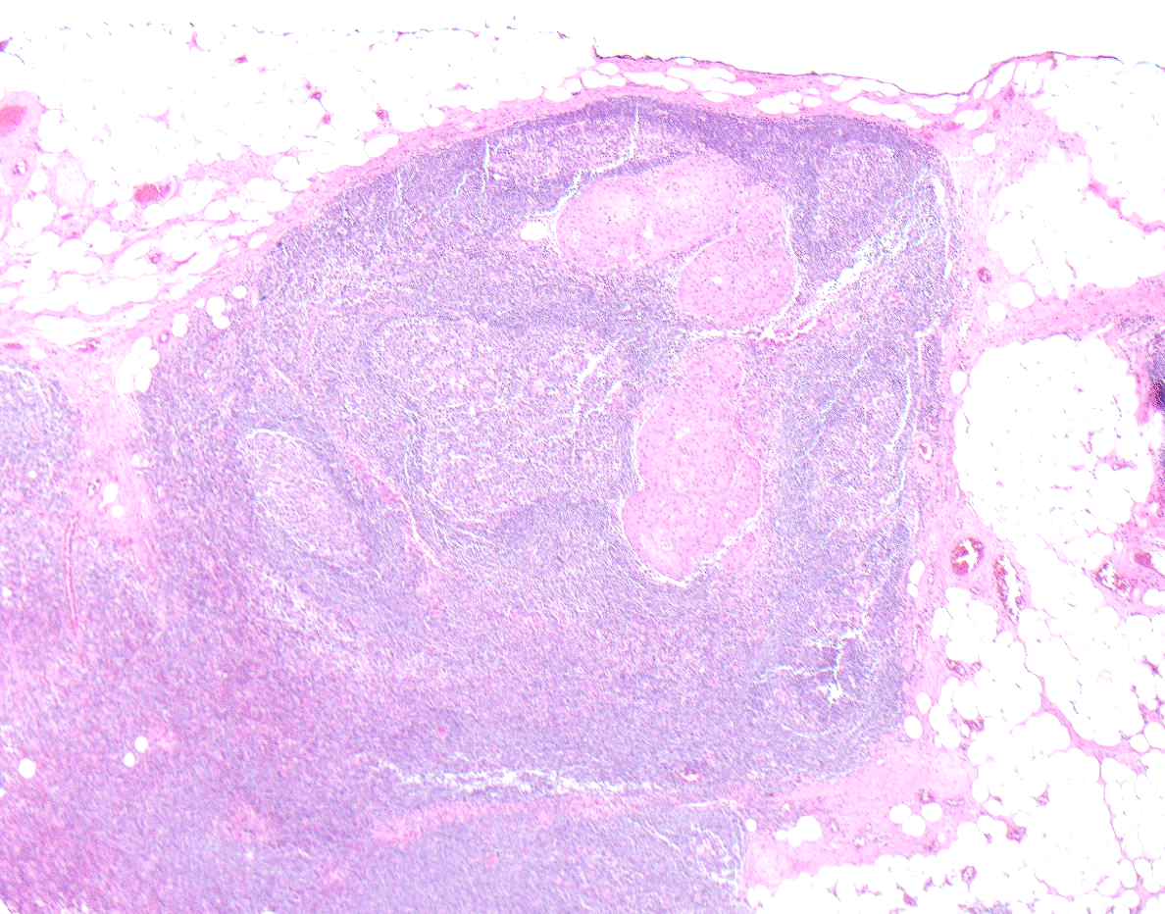
No pENE (Case 2)
Central metastasis away from capsule
Notes:
RDC ADDED

Slide 11
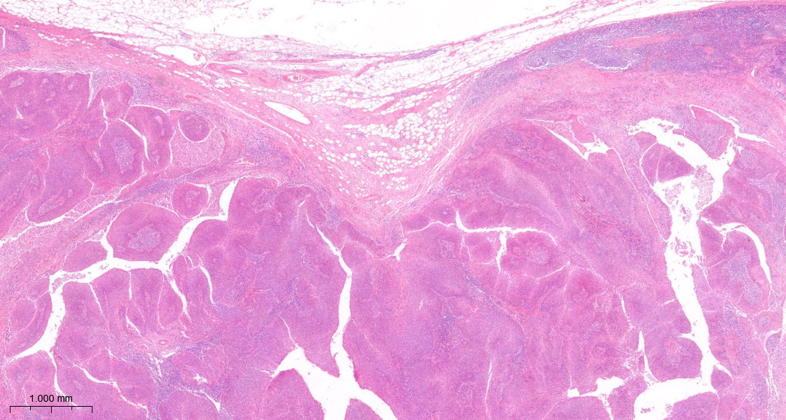
No pENE (Case 3)
Metastatic SCC lies adjacent to the peri-nodal fat (A), but the capsule (B) is intact.
There is no extranodal extension.
B
A
B

Slide 12
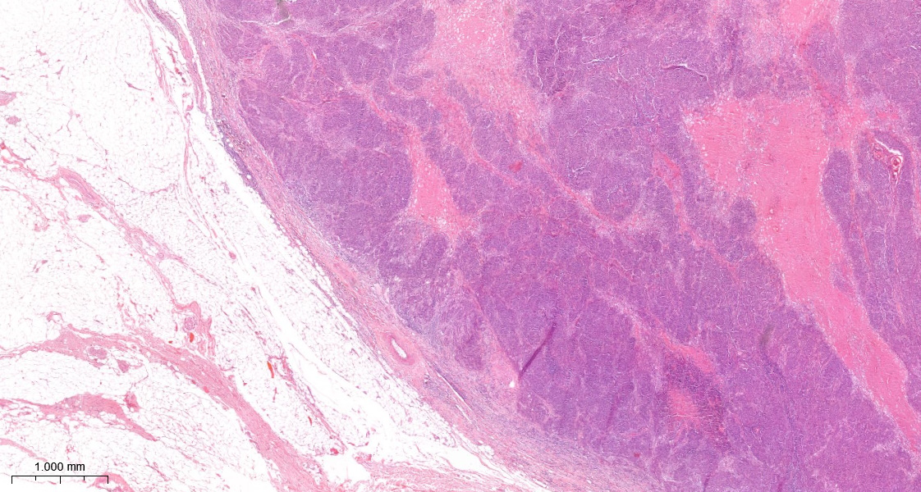
No pENE (Case 4)
Metastatic SCC has effaced the lymph node architecture, but the capsule (A) is intact and fibrotic.
There is no extranodal extension.
A
A
A

Slide 13
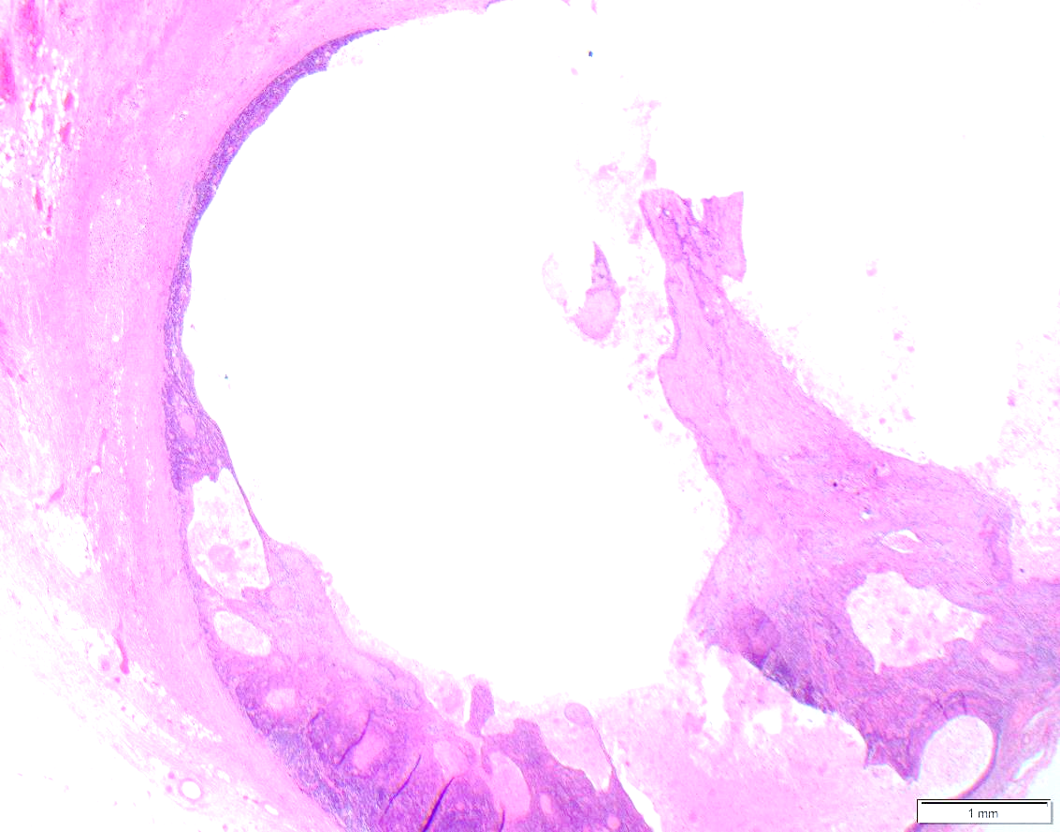
No pENE (Case 5)
Cystic metastasis (A) with thickened pseudocapsule (B)
B
B
A
B
Notes:
RDC ADDED

Slide 14
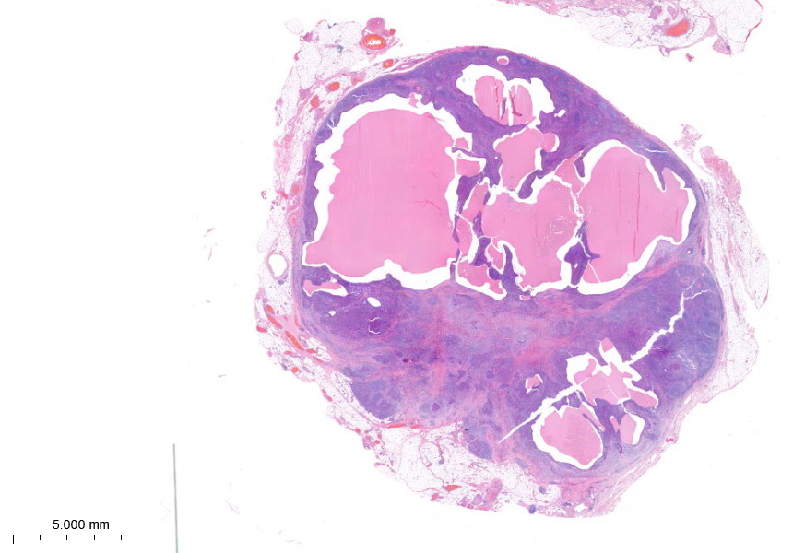
No pENE (Case 6)
Metastatic SCC lies adjacent to the peri-nodal fat, but the tumour is invested by lymphoid tissue suggesting it is still confined to the lymph node. There is no extranodal extension.

Slide 15
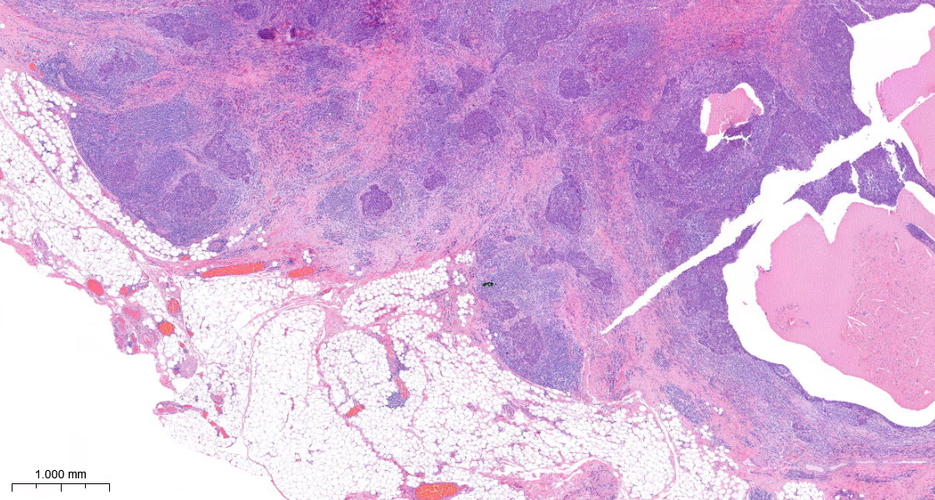
No pENE (Case 6 high power)
Metastatic SCC lies adjacent to the peri-nodal fat (A), but the tumour is invested by lymphoid tissue (B), suggesting it is still confined to the lymph node. There is no extranodal extension.
B
A

Slide 16
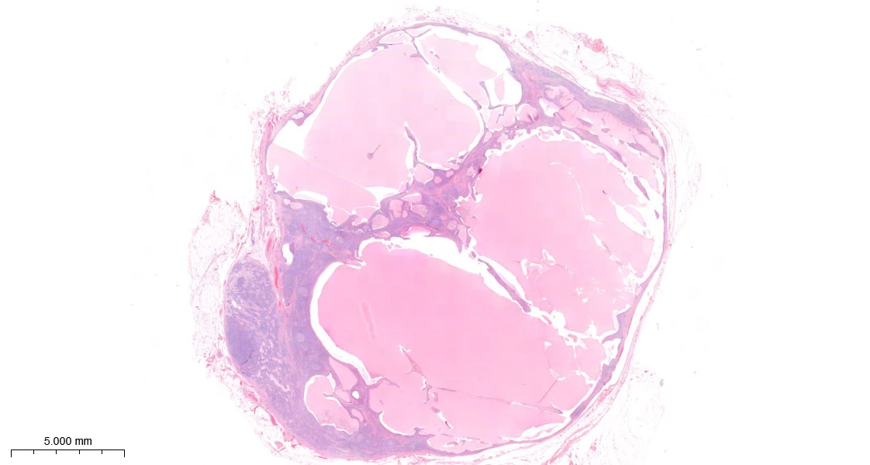
No pENE (Case 7)
A cystic metastasis has effaced the lymph node architecture, but the capsule is intact and fibrotic. There is no extranodal extension.

Slide 17
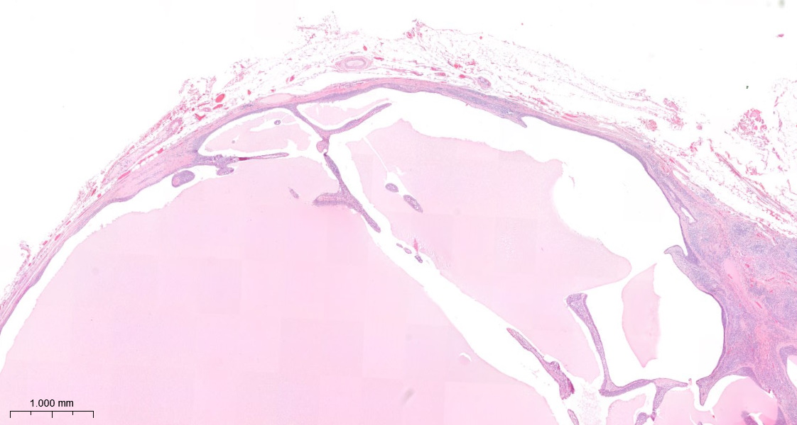
No pENE (Case 7 high power)
A cystic metastatic SCC has effaced the lymph node architecture, but the capsule (A) is intact.
There is no extranodal extension.
A
A
A

Slide 18
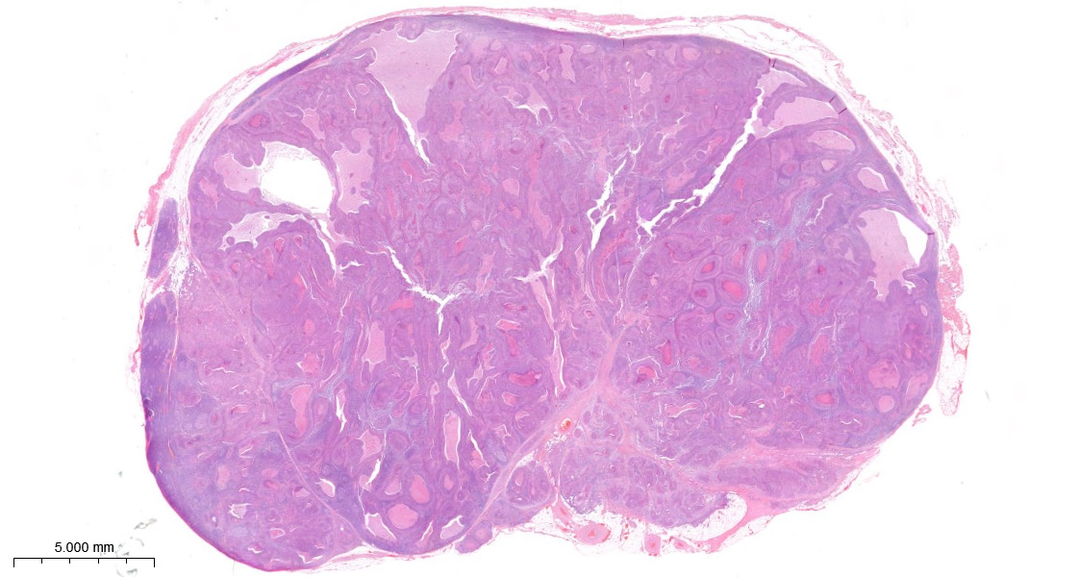
No pENE (Case 8)
Metastatic SCC extends into the hilum of the lymph node, but the tumour is invested by lymphoid tissue, suggesting it is still confined to the lymph node. There is no extranodal extension.

Slide 19
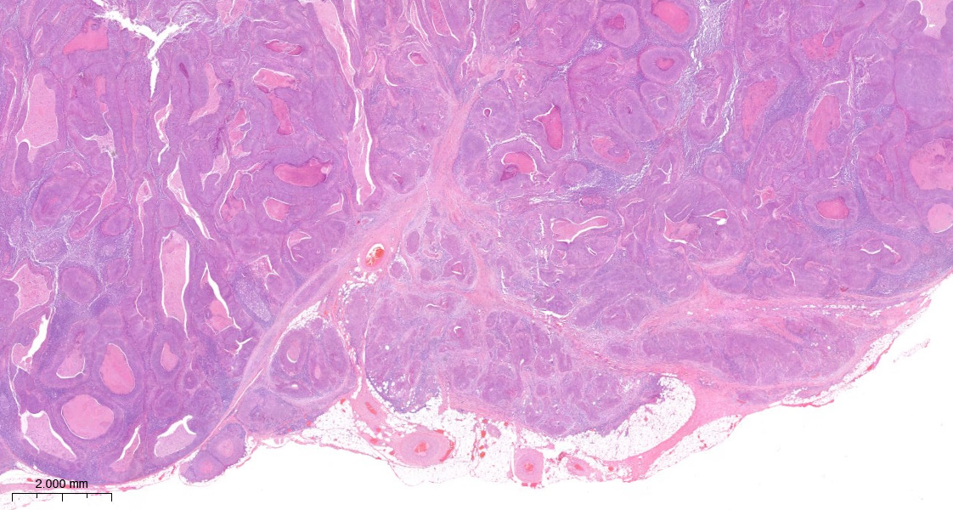
No pENE (Case 8 high power)
Metastatic SCC extends into the hilum of the lymph node, but the tumour is invested by lymphoid tissue, suggesting it is still confined to the lymph node. There is no extranodal extension.
Hilar vessels

Slide 20
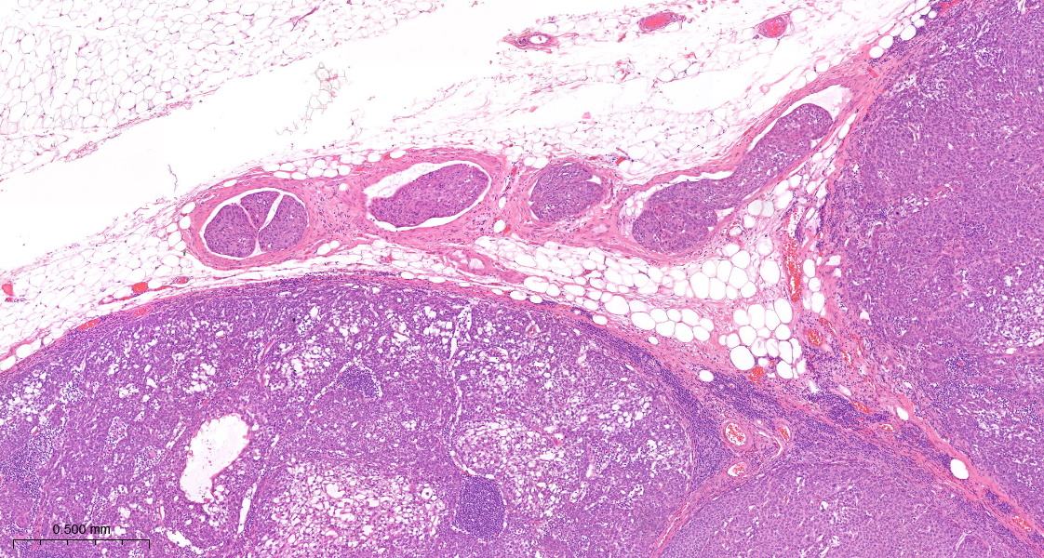
No pENE (Case 9)
SCC in a peri-nodal lymphatic channel. There is no extranodal extension.
Lymphatic channel

Slide 21
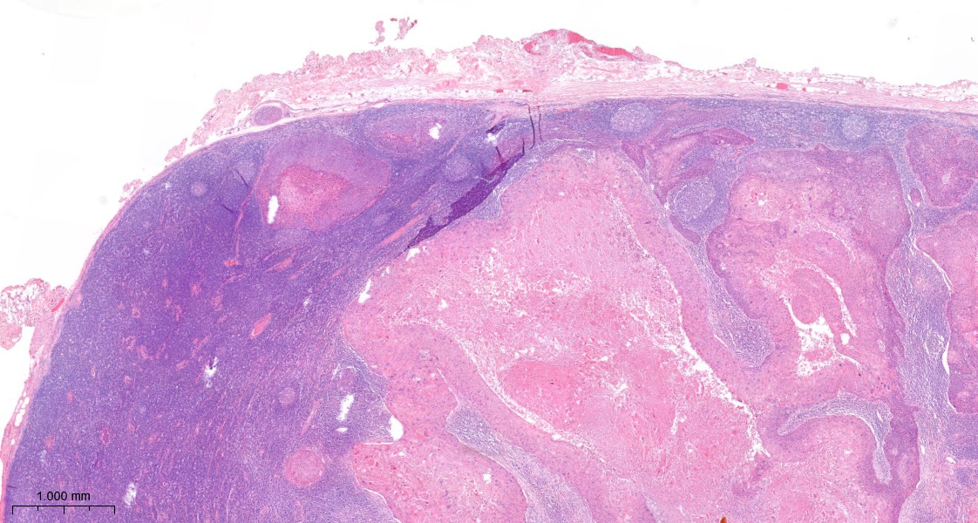
No pENE (Case 10)
SCC in a peri-nodal vessel. There is no extranodal extension.

Slide 22
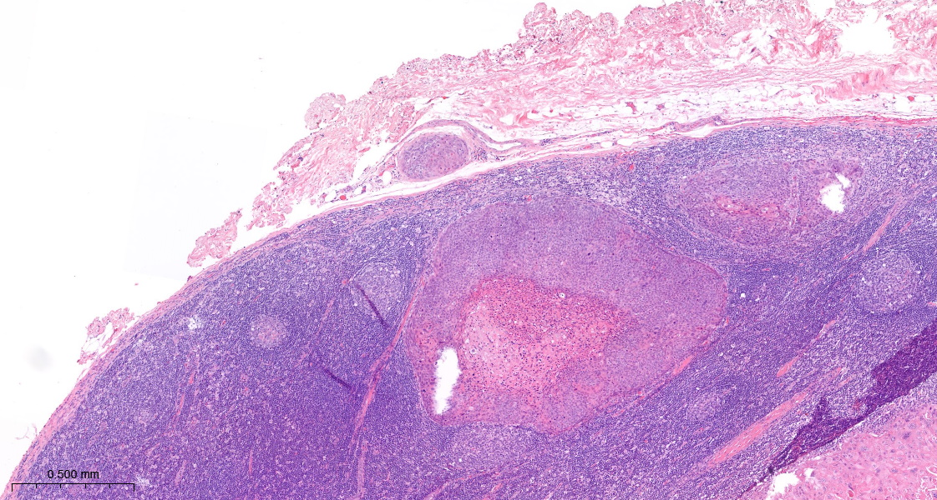
No pENE (Case 10 high power)
SCC in a peri-nodal vessel. There is no extranodal extension.

Slide 23
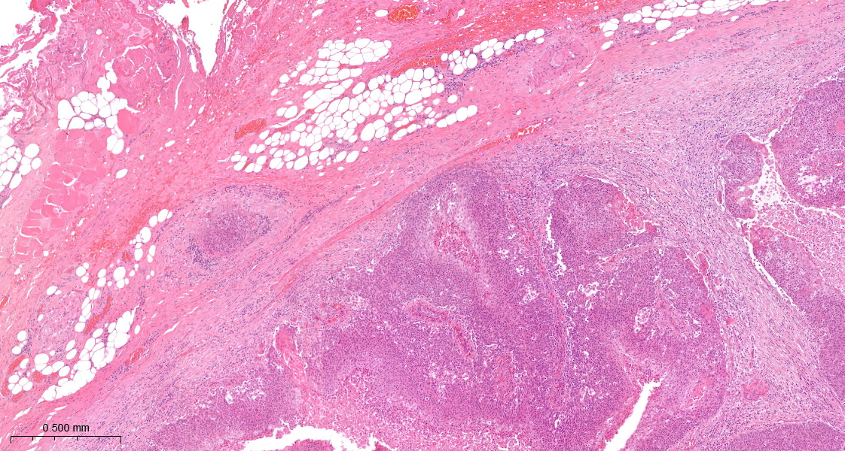
No pENE (Case 11)
SCC in a peri-nodal vessel. There is no extranodal extension.

Slide 24
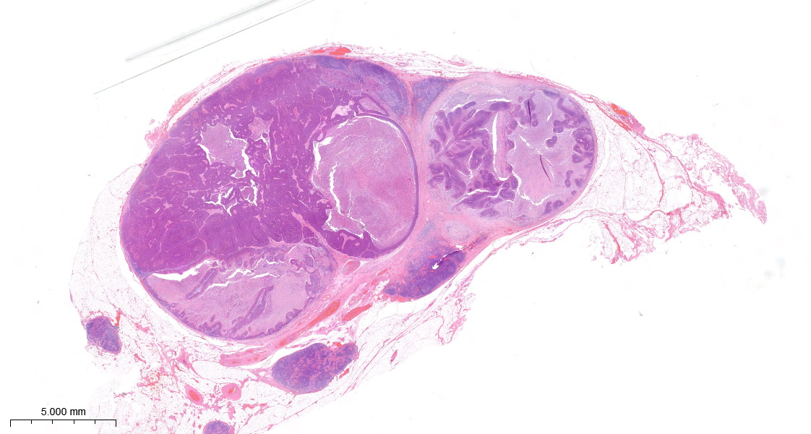
No pENE (Case 12)
Two lymph nodes that contain metastatic SCC. The lymph nodes are fused by fibrosis of the capsule, rather than as a consequence of extranodal extension. There is no invasion of the peri-nodal fat.

Slide 25
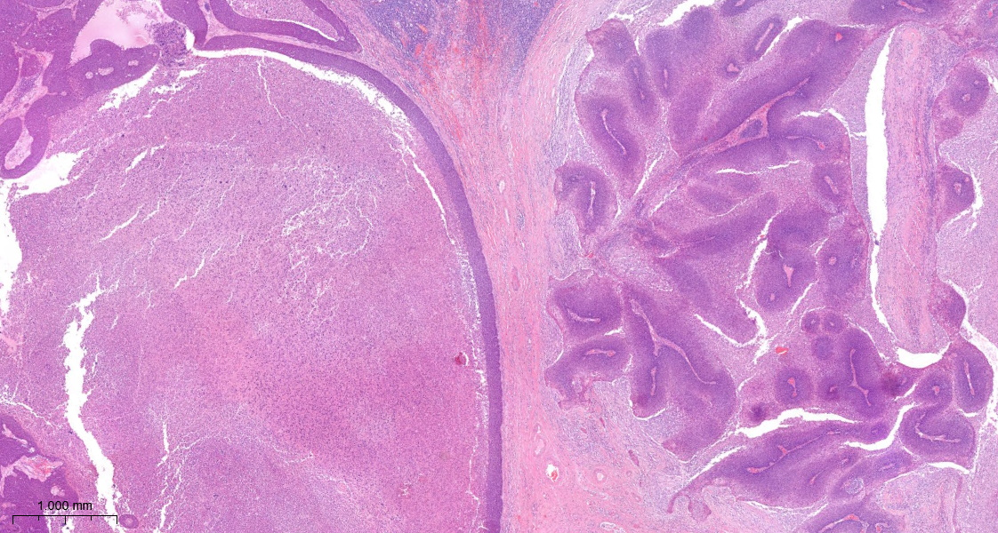
No pENE (Case 12 high power)
Two lymph nodes that contain metastatic SCC. The lymph nodes are fused by fibrosis of the capsule, rather than as a consequence of extranodal extension.

Slide 26
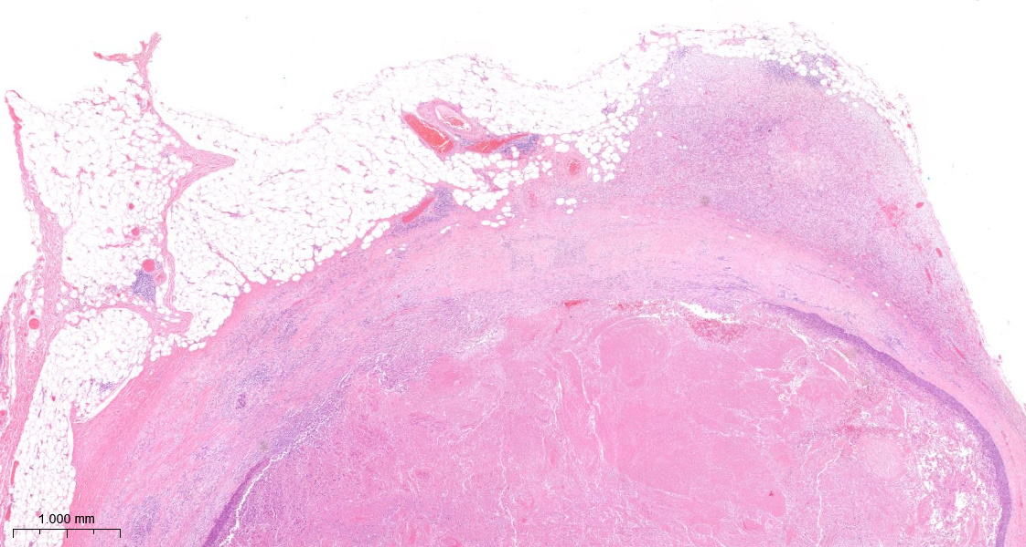
No pENE (Case 13)
A lymph node that contains metastatic SCC. The periphery of the lymph node has been disrupted by a core biopsy. There are accumulations of macrophages (A) and fibrosis (B). The metastasis is discontinuous (C) and shows central degeneration (D). There is a fragment of disrupted tumour in the fibrotic capsule (red circle), but no extranodal extension.
A
B
C
D

Slide 27
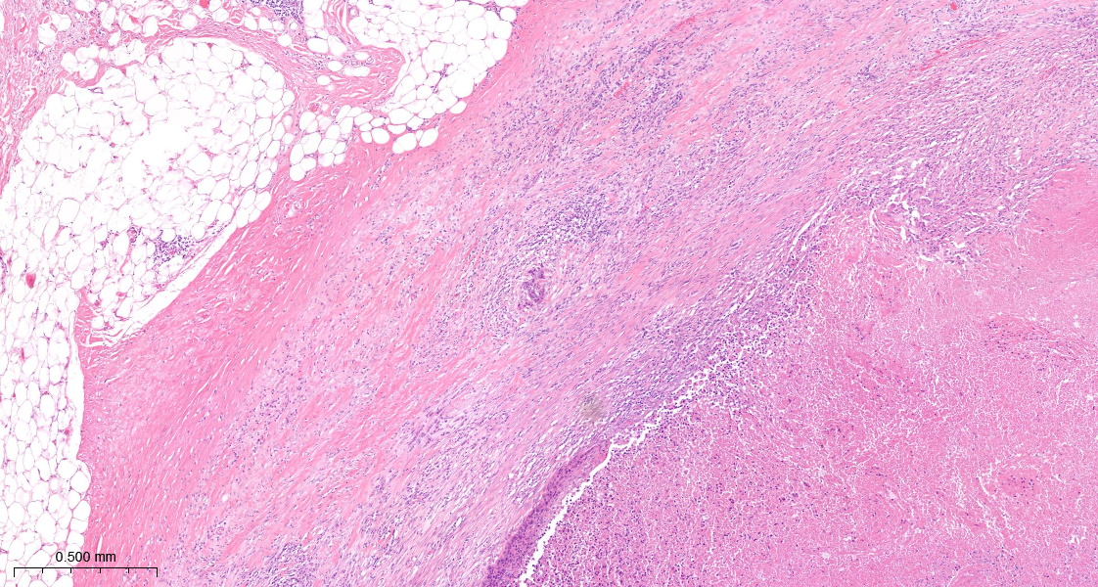
No pENE (Case 13 high power)
The periphery of the lymph node has been disrupted by a core biopsy. There are accumulations of macrophages (A) and fibrosis (B). The metastasis is discontinuous (C) and shows central degeneration (D). There is a fragment of disrupted tumour in the fibrotic capsule (red circle), but no extranodal extension.
B
A
C
D

Slide 28
Examples of cases that have minor or major pENE

Slide 29
Standardised definitions and diagnostic criteria for extranodal extension on histopathological examination in head and neck cancer: HNCIG international consensus recommendations
Reporting of pENE: Major and minor pENE should be explicitly reported Major pENE is extension of tumour >2mm beyond nodal capsule Minor pENE is extension of tumour <=2mm beyond nodal capsule Number of lymph nodes that have pENE should be reported Size of the largest lymph node that has pENE should be reported Precise measurement for the vertical/perpendicular extent of pENE away from the lymph node capsule should NOT be reported

Slide 30
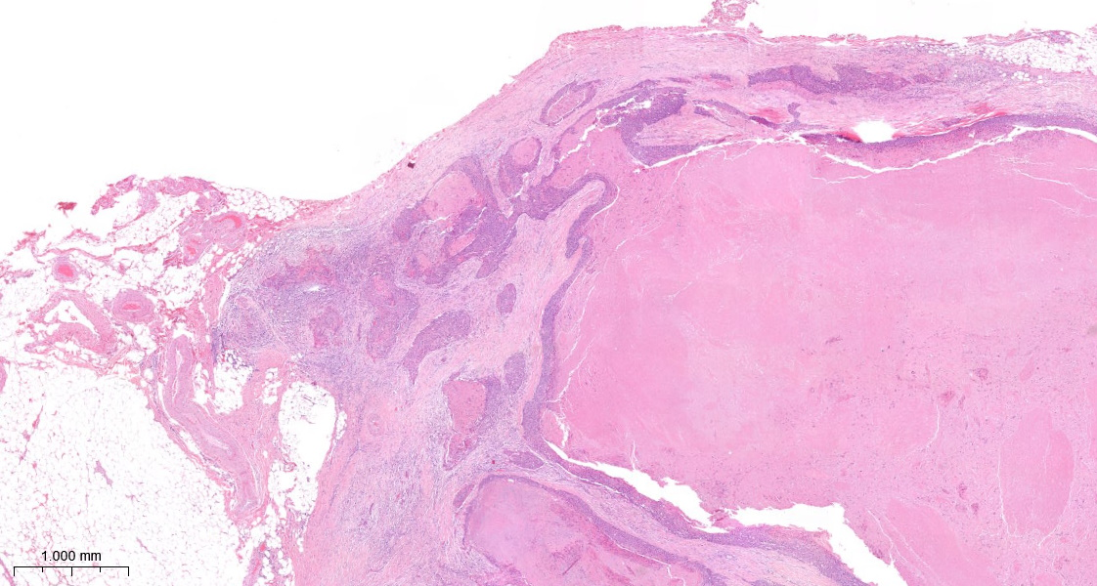

Minor pENE (Case 14)
Metastatic SCC with focal invasion of the peri-nodal fibro-adipose tissue. The tumour is estimated to extend 1mm from the periphery of the lymph node; minor extranodal extension.
1.0mm

Slide 31
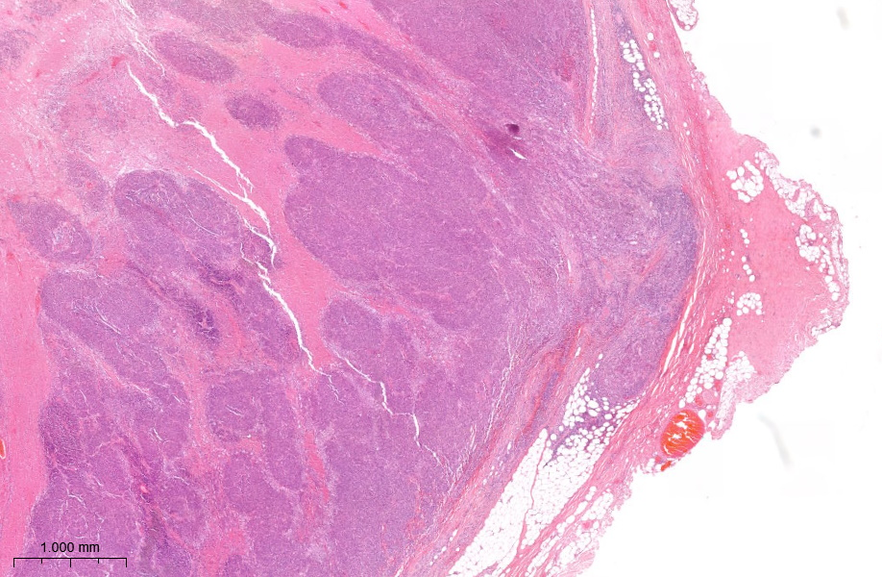
Minor pENE (Case 15)
Metastatic SCC with focal invasion of the peri-nodal fibro-adipose tissue. The tumour is estimated to extend 1mm from the periphery of the lymph node; minor extranodal extension.
1.0mm

Slide 32
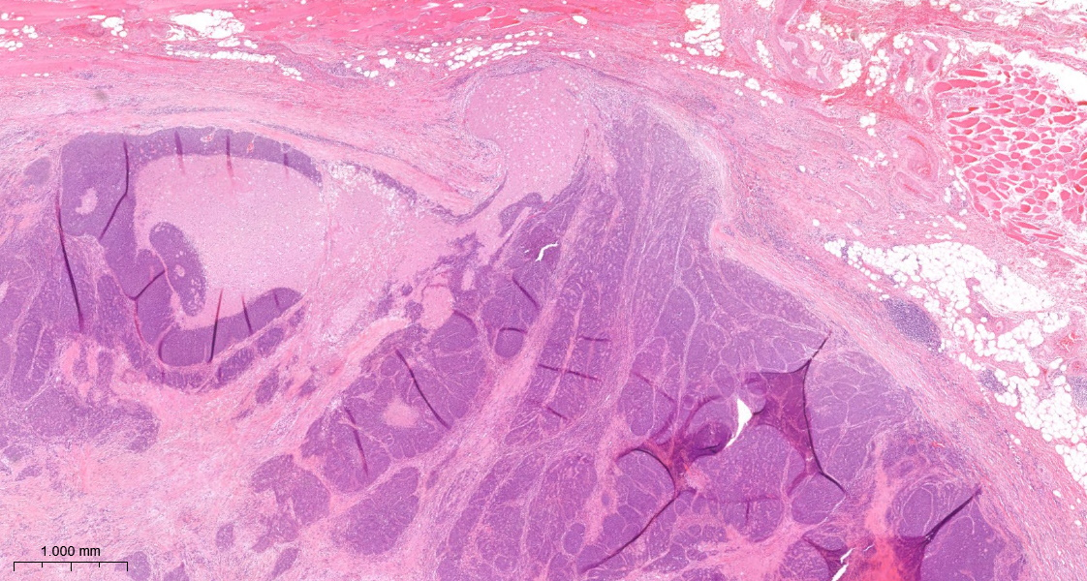
Minor pENE (Case 16)
Metastatic SCC with focal invasion of the peri-nodal fibro-adipose tissue. The tumour is estimated to extend 1mm from the periphery of the lymph node; minor extranodal extension.
1.0mm

Slide 33
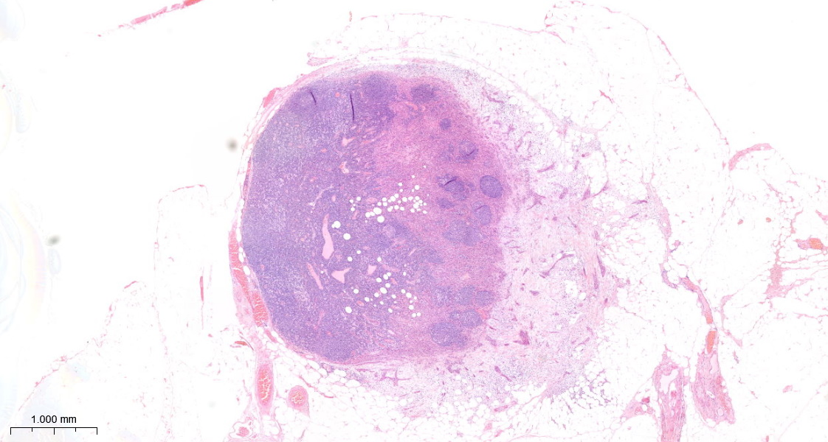
Minor pENE (Case 17)
A small lymph node with metastatic SCC that shows a non-cohesive pattern of invasion into the peri-nodal fibro-adipose tissue.

Slide 34
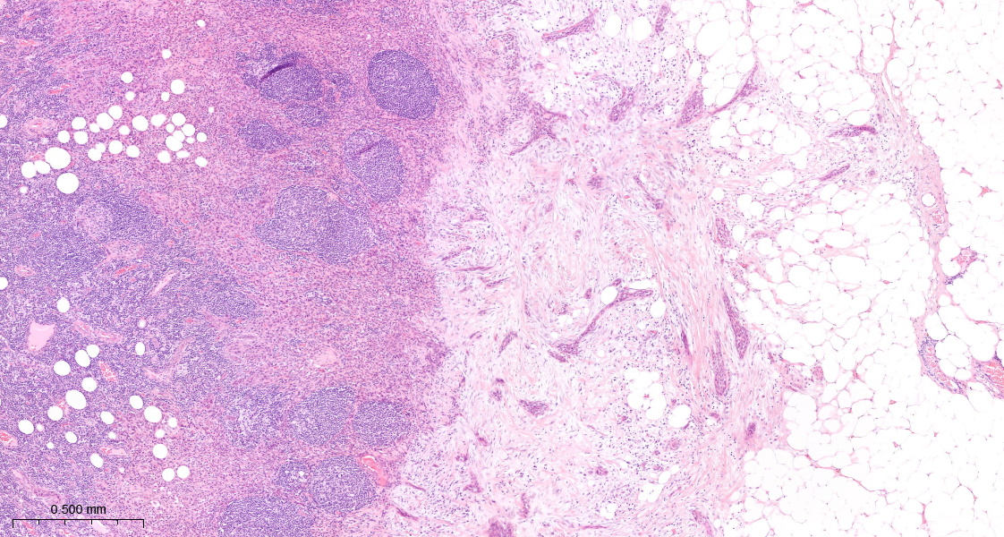
Minor pENE (Case 17 high power)
A small lymph node with metastatic SCC that shows a non-cohesive pattern of invasion into the peri-nodal fibro-adipose tissue. The tumour is estimated to extend 1.5mm from the periphery of the lymph node; minor extranodal extension.
1.5mm

Slide 35
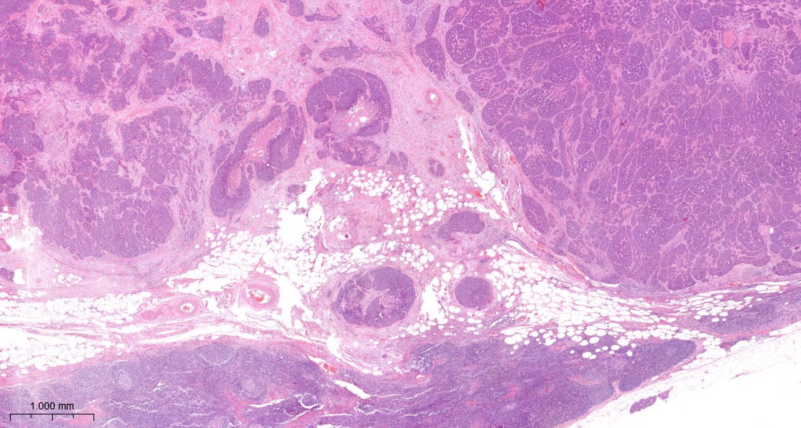
Minor pENE (Case 18)
Metastatic SCC extends into the hilum of the lymph node and there is invasion of the hilar fat. The tumour is estimated to extend 2mm into the hilar fat; minor extranodal extension.
2.0mm
Hilar vessels

Slide 36
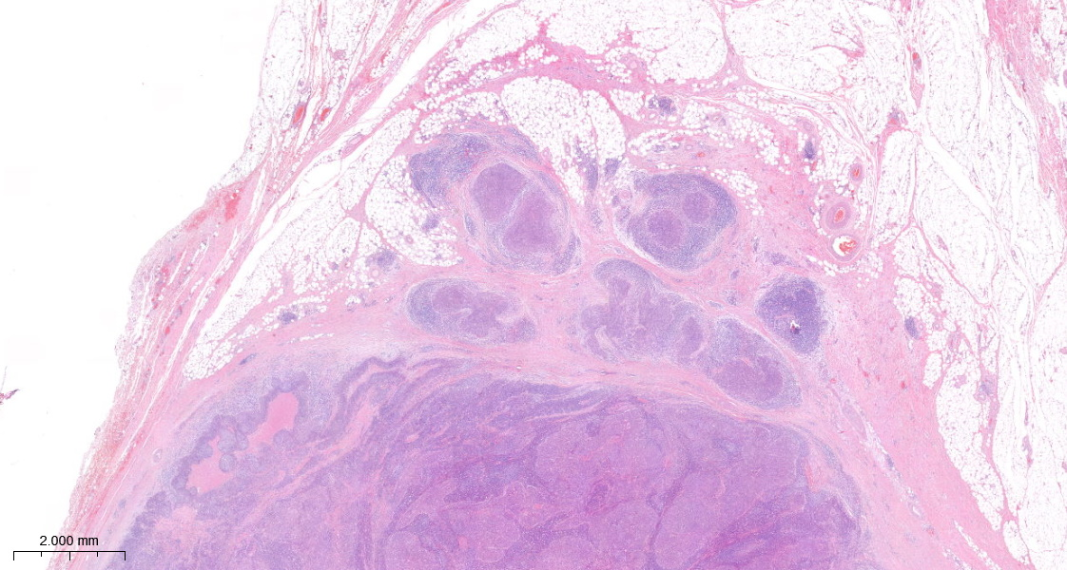
Major pENE (Case 19)
Metastatic SCC that shows invasion into the peri-nodal fibro-adipose tissue. The tumour is estimated to extend 3mm from the periphery of the lymph node; major extranodal extension.
3.0mm

Slide 37
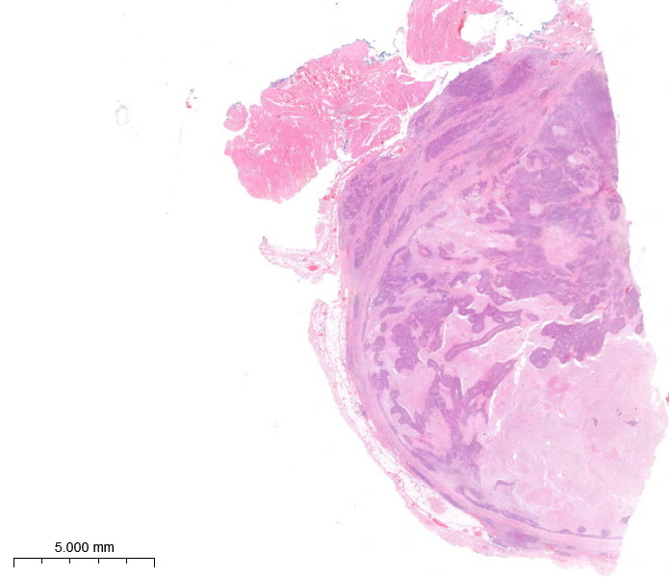
Major pENE (Case 20)
Metastatic SCC that shows invasion into the peri-nodal fibro-adipose tissue.

Slide 38
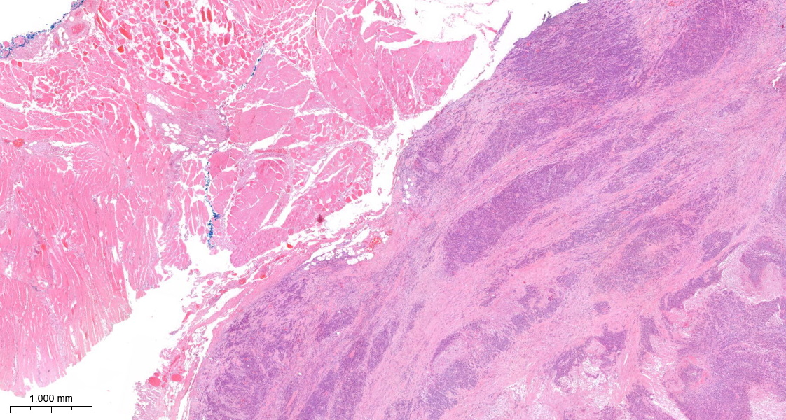
Major pENE (Case 20 high power)
Metastatic SCC that shows invasion into the peri-nodal fibro-adipose tissue. The tumour is estimated to extend 3.6mm from the periphery of the lymph node; major extranodal extension.
3.6mm

Slide 39
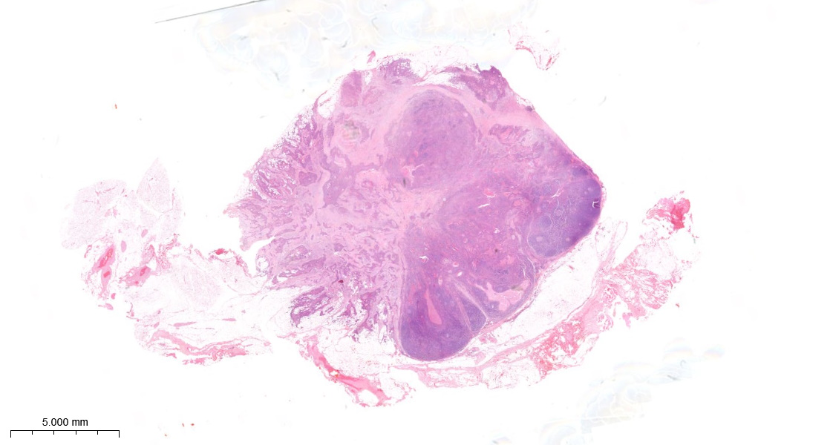
Major pENE (Case 21)
Metastatic SCC that shows invasion into the peri-nodal fibro-adipose tissue. The tumour is estimated to extend 8mm from the periphery of the lymph node; major extranodal extension.
8.0mm

Slide 40
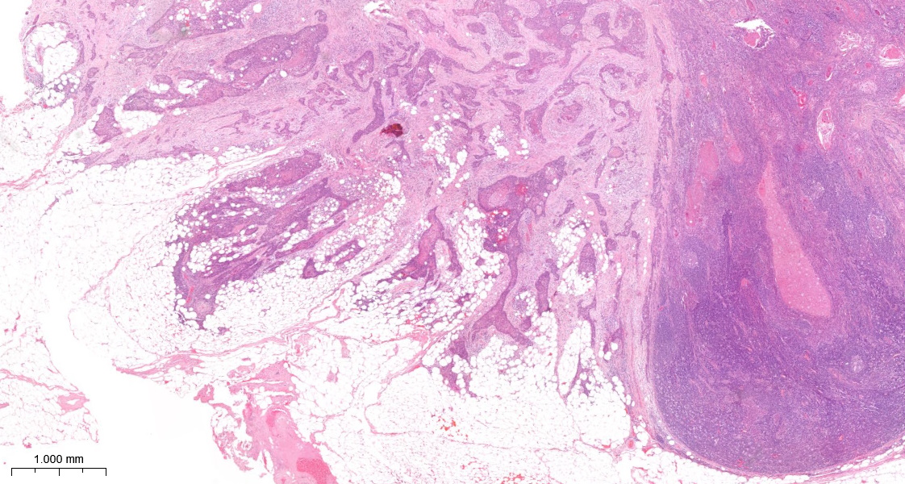
Major pENE (Case 21 high power)
Metastatic SCC that shows invasion (red arrows) into the peri-nodal fibro-adipose tissue; major extranodal extension

Slide 41
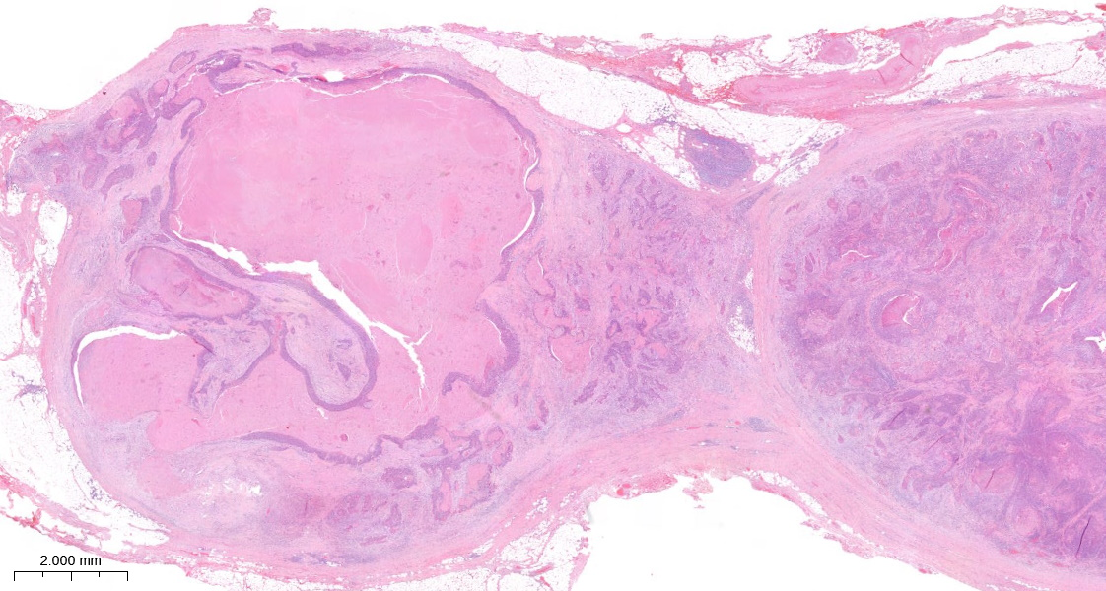
Major pENE (Case 22)
Two lymph nodes that contain metastatic SCC. The lymph nodes are fused by major extranodal extension (estimated to measure >2mm).

Slide 42
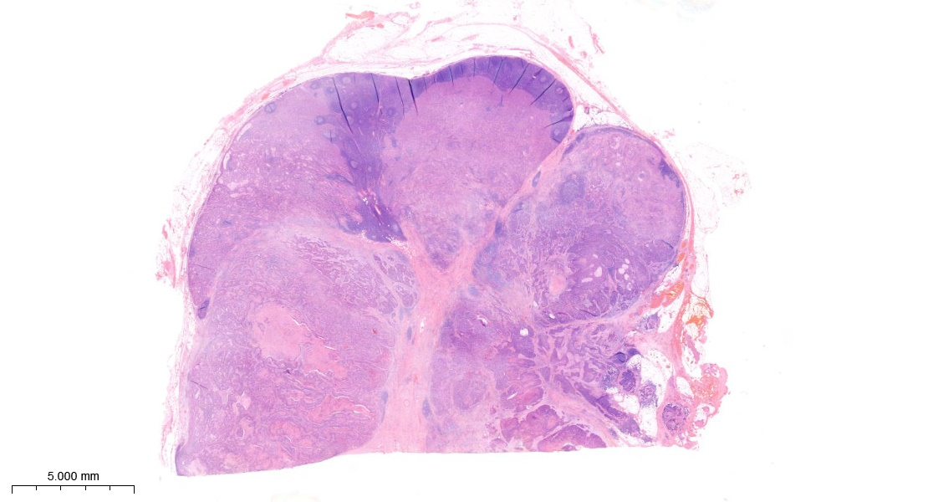
Major pENE (Case 23)
Fused lymph nodes that show major extranodal extension (>2mm, a precise measurement is not feasible, red circle).

Slide 43
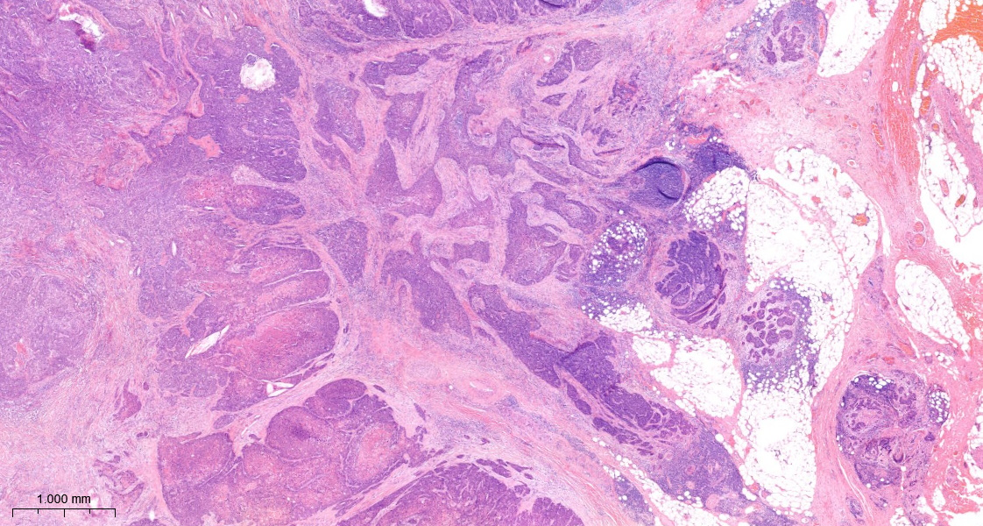
Major pENE (Case 23 high power)
Fused lymph nodes that show major extranodal extension (>2mm, a precise measurement is not feasible).

Slide 44
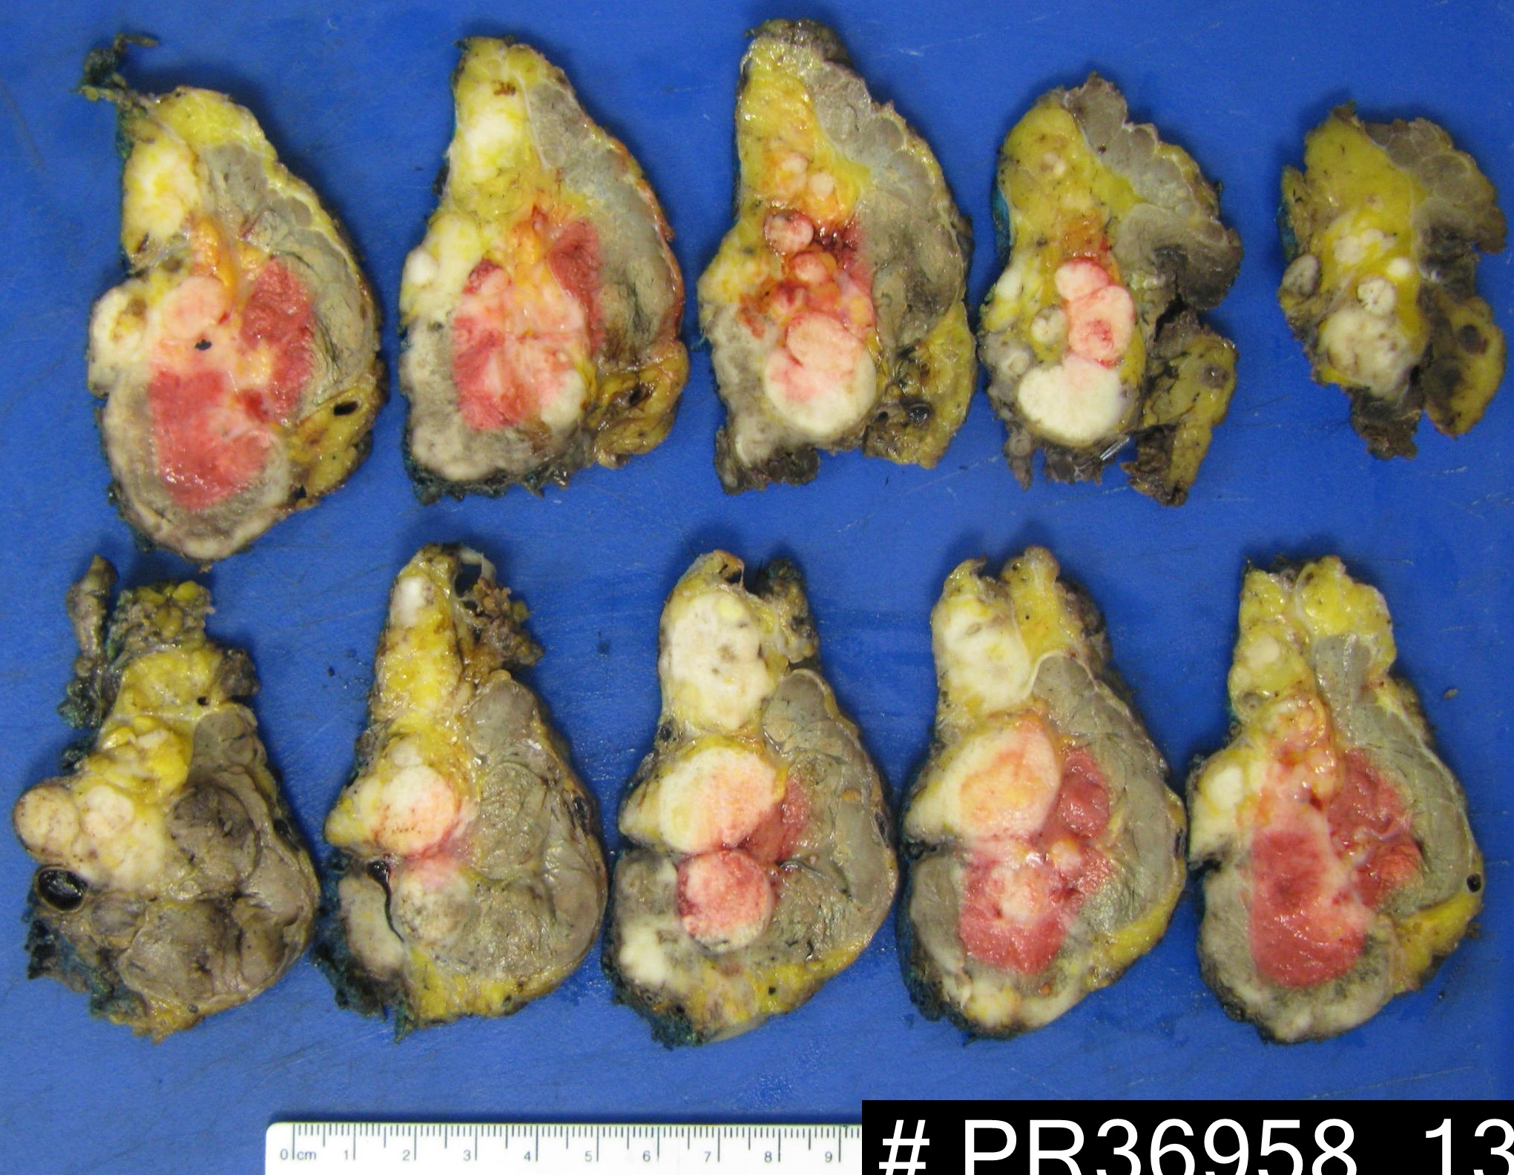
Neck dissection with fused lymph nodes and major pENE (Case 24)
SCM=sternocleidomastoid muscle, IJV=internal jugular vein.
Fat
SCM
Tumour
IJV

Slide 45
Examples of cases with Soft Tissue Metastases (STM)

Slide 46
Standardised definitions and diagnostic criteria for extranodal extension on histopathological examination in head and neck cancer: HNCIG international consensus recommendations
Features diagnostic of STM for both HPV-mediated and HPV-negative HNC: An irregular deposit of tumour in connective tissue, without a microscopically identifiable residual lymph node A circumscribed deposit of tumour without a microscopically identifiable residual lymph node No residual lymph node on all slides of the metastasis There is no minimum dimension required for diagnosis of soft tissue metastasis
Features NOT diagnostic for STM: No residual lymph node on only one slide of the metastasis In-transit metastasis (defined as presence of cancer cells in lymphatics outside nodal tissue)

Slide 47
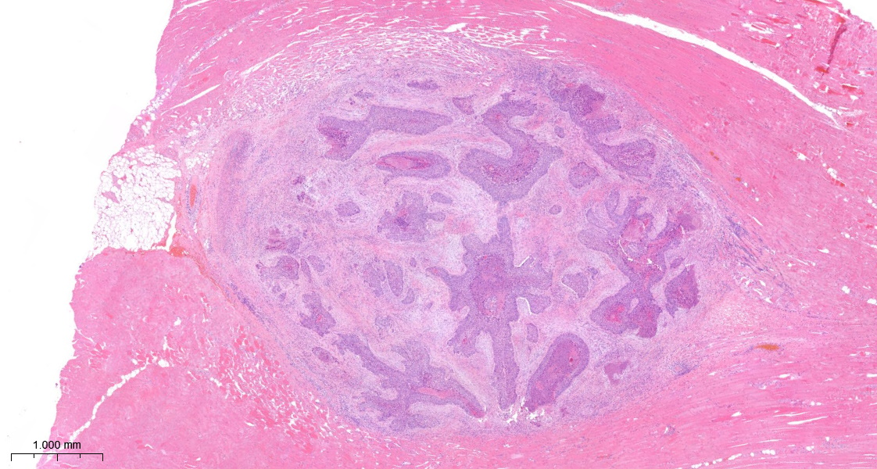
Soft tissue metastasis (Case 25)
Squamous cell carcinoma in striated muscle.

Slide 48
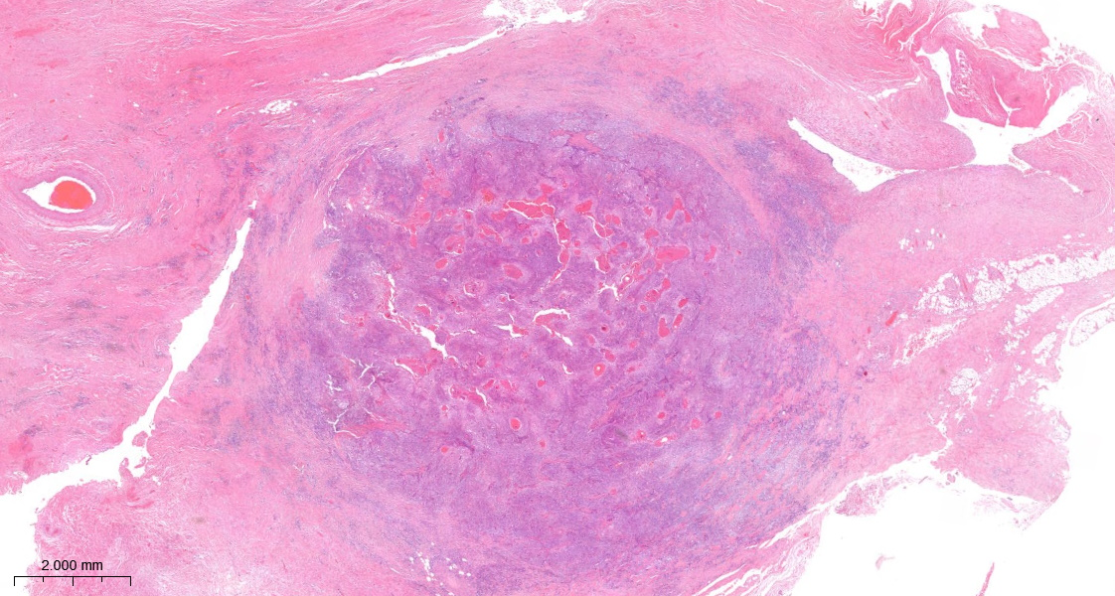
Soft tissue metastasis (Case 26)
Squamous cell carcinoma in dense fibrous tissue. IJV=internal jugular vein.
IJV

Slide 49
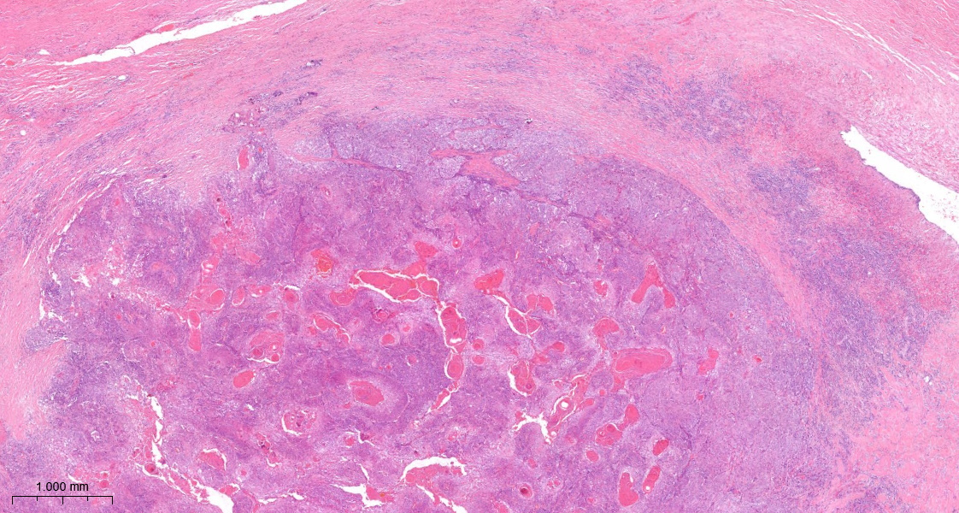
Soft tissue metastasis (Case 26 high power)
Squamous cell carcinoma in dense fibrous tissue. IJV=internal jugular vein.
IJV

Slide 50
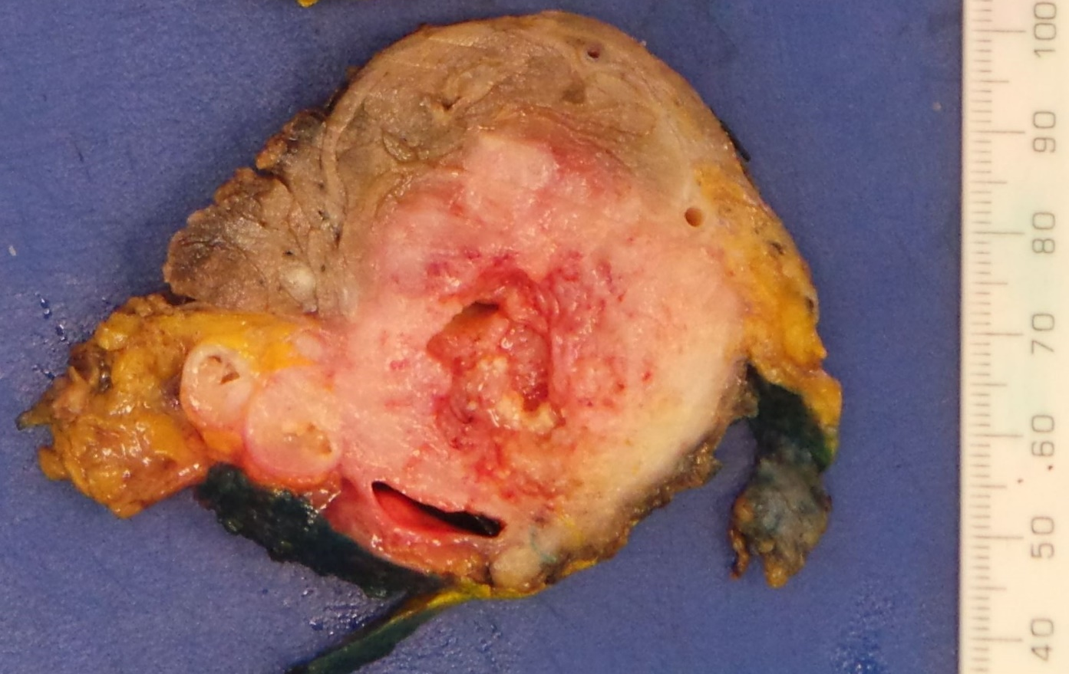
Neck dissection with soft tissue metastasis (Case 27)
SCM=sternocleidomastoid muscle, IJV=internal jugular vein.
SCM
Tumour
Fat
IJV

